Slide 1
General Health for Liver Patients: Top 10 Secrets
Stevan A. Gonzalez, MD MS
Baylor Simmons Transplant Institute
Baylor All Saints Medical Center, Fort Worth &
Baylor University Medical Center, Dallas

Slide 2
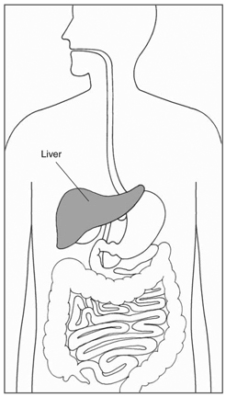
Essential Functions of the Liver
Processing nutrients, medications, & hormones
Production of circulating proteins
Removal of bacteria and toxins
Control of immunity & prevention of infection
Production of bile; fat absorption within GI tract
Storage of fats, sugars, minerals, & nutrients
National Digestive Diseases Information Clearinghouse, NIDDK/NIH

Slide 3
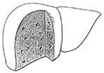
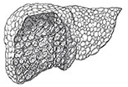
Chronic Liver Disease
Normal liver
Nodular cirrhosis
Inflammation
Injury
Fibrosis
Risk of Liver Cancer
Liver Dysfunction
Liver Failure
Common pathway in virtually all forms of chronic liver disease:
Chronic viral hepatitis
Autoimmune liver disease
Hereditary/Genetic disorders
Alcoholic liver disease
Primary Sclerosing Cholangitis
Metabolic diseases

Slide 4
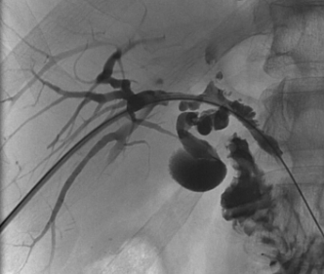
Primary Sclerosing Cholangitis
Chronic inflammatory liver disease
Progressive scarring of bile ducts
Association with inflammatory bowel disease
Variable course, can lead to liver failure

Slide 5
What are the secrets to keeping your liver healthy?

Slide 6
Maintain Good Nutrition
The liver plays a critical role in nutrition
Storage & breakdown of sugars (glycogen)
Production of sugars (gluconeogenesis)
Breakdown of fats
Production of proteins

Slide 7
Maintain Good Nutrition
Advanced liver disease = catabolic state
Increased protein loss
Increased energy requirement
Inadequate dietary intake is common
DO NOT RESTRICT DIETARY PROTEIN
Protein restriction promotes protein loss, worsens nutrition = debilitation, liver failure, risk of complications

Slide 8
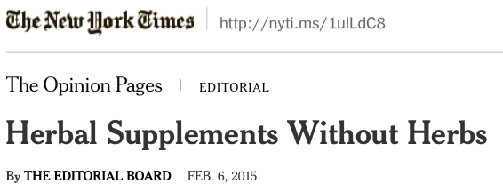
Avoid Herbal Supplements
NY State Attorney General’s Office investigation, 2015
4/5 products did not include herbs listed on label
Hidden ingredients/contaminants
Mostly fillers – rice, beans, vegetables, house plants
www.nytimes.com

Slide 9
Avoid Herbal Supplements
5.6
Manufacturers “regulate” themselves to ensure safety
Scientific evidence required only if claims of “cure” or “prevention”
Billion-dollar industry
5.0
4.0
* These statements have not been evaluated by the Food and Drug Administration. This product is not intended to diagnose, treat, cure, or prevent any disease.
Dietary Supplement Health and Education Act, 1994

Slide 10
Avoid Herbal Supplements
Herbal supplements are a cause of liver failure
Responsible for up to 1/5 cases of liver toxicity
Frequently associated with liver failure & transplantation
No standardization, risk of contamination
Supplements assoc. with hepatotoxicity:
Black cohosh
Green tea
Chaparral
Comfrey
Germander
Kava kava
Saw palmetto
Impila
Greater celandine
Noni juice
Ma-Huang
Glucosamine/chondroitine
Hydroxycut
Oxy Elite Pro
LipoKinetix
Herbalife
Gotu kola
Jin Bu Huan
NIH Drug-Induced Liver injury Network, 2015

Slide 11
Acetaminophen is Safe
Truth: acetaminophen can cause liver failure – but only in an overdose
Safe dose: up to 2,000mg daily
Exception = alcohol use
Careful with acetaminophen-containing products: tylenol, excedrin, vicodin, percocet, lortab, etc.

Slide 12
Alcohol can Accelerate Liver Damage
Risk factor for bile duct cancer in PSC
Accelerates progression of scar tissue in other liver disease states
Increased mortality risk with ≥ moderate alcohol intake (1-2 drinks/day)
Chalasani. Hepatology 2000;31:7
Younossi. Alimentary Pharm Ther 2013;37:703

Slide 13
Alcohol can Accelerate Liver Damage
7.63-fold
2.29-fold
No increase
in risk
No
alcohol intake
Current moderate
alcohol intake
Current excessive
alcohol intake
Younossi. Alimentary Pharm Ther 2013;37:703

Slide 14
Minimize other Health Problems
Follow up with your primary care physician
Cholesterol screening
Bone density scans
Preventive medicine
Cancer screening (colonoscopy, mammogram)
Hepatitis A/B vaccines, flu shot, etc.
Inflammatory bowel disease
Diabetes, cardiovascular disease

Slide 15
Stay Lean
Maintain a low-fat diet, exercise
Nonalcoholic fatty liver disease can develop along with other liver diseases
Fatty liver is preventable & reversible in many cases
Closely linked to:
Weight gain
Diabetes
High cholesterol

Slide 16
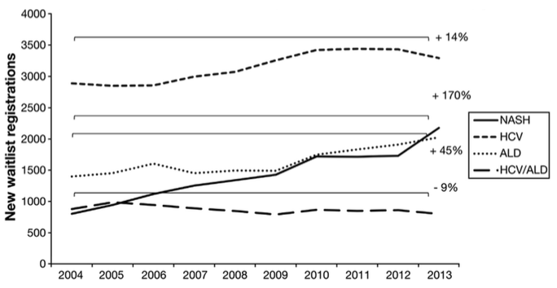
Stay Lean
Non alcoholic fatty liver disease is currently the fastest growing indication for liver transplantation
Wong. Gastroenterology 2015;148:547

Slide 17
Stay Active
Maintain your activity level as much as possible
Avoid muscle loss
Maintain strength & mobility
Exercise regularly
Keep working as long as you can

Slide 18
Be Engaged
Keep your appointments
Follow treatment protocols
Labs, imaging, procedures
Prevention & early recognition is key
Stay up to date on vaccinations
Know your medications
Maintain your health insurance

Slide 19
Other Things to Avoid:
Anti-inflammatory meds (NSAIDS) should be avoided in cirrhosis
Narcotics
Sedatives
Tobacco
Colonics, cleanses, miracle cures

Slide 20
Communicate with your Doctor
Find a doctor that understands your illness
Keep them updated on side effects of medications
Call if you develop new or worsening symptoms
You can avoid the ER in many cases
136 million visits/yr in the US
Be nice to the nurses!

Slide 21
Final Thoughts
You have a major role in maintaining your health
External factors can influence the progression of liver disease
There are no “secrets”
Good nutrition & a healthy lifestyle is the key
Communicate with your healthcare providers
We want to hear from you!

