Slide 1
The Human Microbiome: PSC, IBD, and the Gut-Liver Axis
Peter Mannon, MD
The University of Alabama at Birmingham
PSC Partners Seeking a Cure
11th Annual Conference
April 25, 2015
Irving, Texas

Slide 2
What do we talk about when we talk about the Gut Microbiome?
What is the connection between the Gut Microbiome and IBD?
Is the Gut Microbiome important to PSC?

Slide 3
THE LANGUAGE OF THE MICROBIOME
Microbiota | The microbial organisms that make up the microbiome (bacteria, archaea, viruses, fungi)
Microbiome | The sum of the microbes, their genetic information, and their ecological niche
Metagenome | The totality of genes from the genomes of a mixed microbial population that provides information about the functional (genetic) potential of the population as a whole
Dysbiosis | A state of disturbance in the normal microbiome

Slide 4
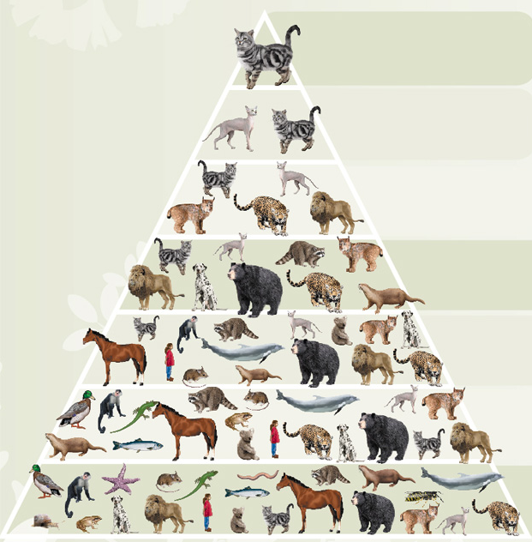
Taxonomy: Organization
Species
Escherichia coli
Genus
Escherichia
Family
Enterobacteriaceae
Order
Enterobacteriales
Class
Gamma Proteobacteria
Phylum
Proteobacteria
Kingdom
Bacteria

Slide 5
The Gut Microbiome
10¹⁴ individual gut microbes/person
In health, provides essential nutrients and maximizes calorie extraction from food
Essential for stimulating the epithelial barrier and for “educating” the early gut immune system

Slide 6
The Gut Microbiome: How do we study it?
Culture-independent methods:
Next-Gen sequencing to identify organisms (abundance and diversity)
Metagenomics to list all the microbial genes present and assess the potential function
Metabolomics to directly measure microbial activity

Slide 7
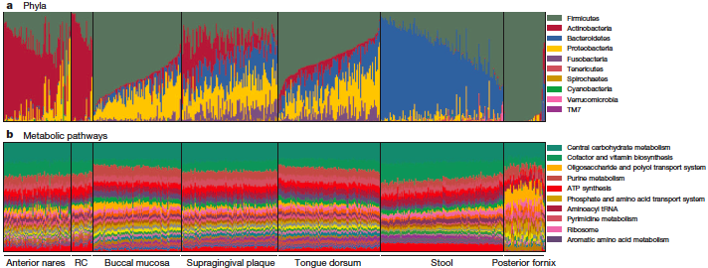
The Human Microbiome Project: Defining the Microbiota in Healthy US Adults
HMP, Nature, 2012

Slide 8
The Gut Microbiome: What affects it?
Diet
Drug exposure
Disease state
Genetic background
Maternal exposure

Slide 9
The Gut Microbiome and IBD
The current model for Crohn’s etiology is a dysregulated immune response to the gut microbiome
?An altered microbiome in IBD (“Dysbiosis”)—yes, but is it a cause or effect
Breakdown in the tolerance of CD and UC patients to gut microbiota

Slide 10
The Dysbiotic Gut Microbiome in IBD
Reduced abundance and diversity in phyla Firmicutes (esp. Faecalibacterium prausnitzii in Crohn’s) and Verrucomicrobia (Akkermansia muciniphila in UC )
Generally increase in Bacteroidetes and Proteobacteria
Fewer microbial genes and functional pathways

Slide 11
Microbiota that Cause IBD?
Microbiota from animal models with gene defects can transmit colitis
IgA antibody-coated bacteria increase IBD susceptibility
Take away: No single organism yet identified but host genetics can influence the microbiome and host responses can identify “bad actors”

Slide 12
How Could the Gut Microbiota Promote Liver Disease?
Altering Energy Harvest
Producing Toxic Metabolites
Promoting Inflammation

Slide 13
The Liver-Gut Axis
Direct venous drainage from colon to liver
“Leaky gut” associated with increased blood levels of pathogen-associated molecular patterns “PAMPs”

Slide 14
The Liver-Gut Axis
Mouse models of NAFLD require presence of a gut microbiome (and blocking PAMP signals can block development of NAFLD)
Transmit susceptibility to NAFLD by transfer of gut microbiome from mice with inflammasome defects (who also develop NAFLD and have altered microbiota with elevated Prevotella and Porphyromonas sp.)

Slide 15
The Gut Microbiome and PSC
Infection
Effects of Components (PAMPs and NODs), “Leaky Gut”
Effects of Metabolism

Slide 16
The Gut Microbiome and PSC: Infection
Models of infection resulting in PSC
Jejunal blind loops in rats (mutanolysin Rx)
Rectal N-Met-Leu-Tyr (small duct cholangitis)
S. intermedius in Balb/c mice
Takeaway: Bacterial infection and bacterial components alone can induce a PSC disease in susceptible animal models—and anti-bacterial strategies can block the damage

Slide 17
The Gut Microbiome and PSC: Infection
Trials of antibiotics
Author | Abx | Dur (Mo.) | Δ Alk Phos | Δ ALT,AST
Farkkila, et al. (2004) | Flagyl (+ UDCA) | 36 | 52% | 41-68%
Silviera, et al. (2009) | Minocycline | 12 | 20% | 3%
Tabibian, et al. (2013) | Vancomycin or Flagyl | 3 | 42% | 22%
Takeaway: Antibiotics can induce improvement but need to assure benefit>risk and actually changes the natural history of PSC

Slide 18
The Gut Microbiome and PSC: Microbial Components
What are PAMPs and NODs?

Slide 19
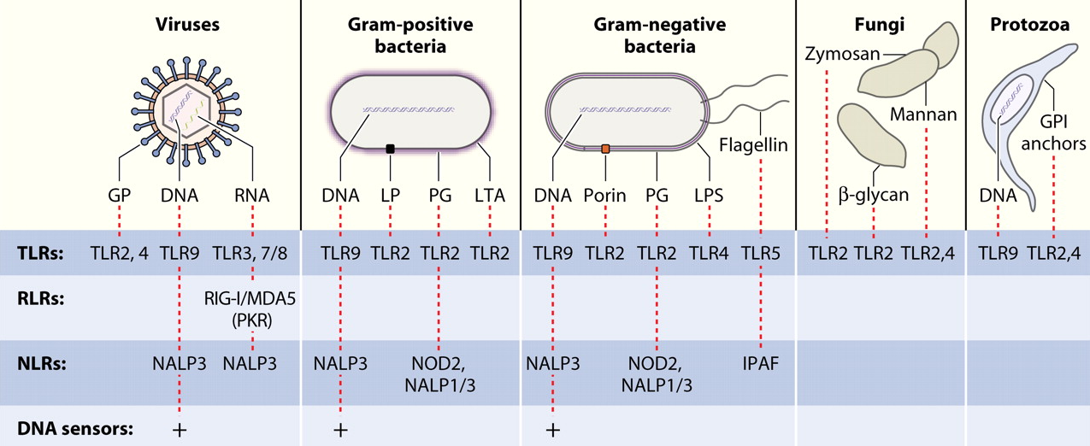
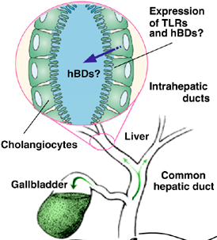
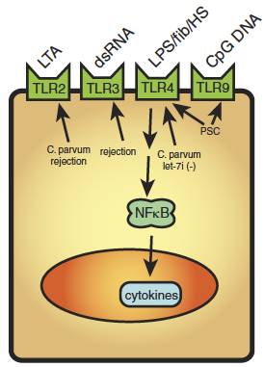

Slide 20
The Gut Microbiome and PSC: Microbial Components
Human data
Cholangiocytes increased TLR (for PAMPs), NLR (for NODs) signaling
PSC cholangiocytes don’t down-regulate response to PAMPs
PSC cholangiocytes accumulate LPS

Slide 21
The Microbiome in PSC: Potential Therapeutics
Modify the Microbiome: prebiotics, probiotics, fecal transplant
Tighten up the “leaky gut”: zonulin antagonist, probiotics
Block TLR signaling: NFκB inhibitors
Block microbial antigen-specific T cells: vedolizumab
Block inflammatory signals: JAK inhibitors, anti-cytokine antibodies

