Slide 1
PSC in Pediatric Inflammatory Bowel Disease Current and Future Implications
Ashish S. Patel, MD
Associate Professor
UT Southwestern Medical Center

Slide 2
Primary sclerosing cholangitis
Chronic hepatobiliary condition
Characterized by: Inflammation of the intrahepatic and/or extrahepatic ducts
Resulting in: Focal dilation, narrowing or destruction accompanied by local periductular fibrosis
End stage: biliary cirrhosis or liver failure

Slide 3
Sclerosing colangititis in childhood
Differentiated by primary and secondary
Primary
Inflammatory Bowel Disease
Crohn’s disease and Ulcerative colitis
Autoimmune disease
Celiac, Diabetes, Lupus, Psoriasis, Pancreatitis, Hepatitis (Overlap syndrome), Thyroiditis
Inflammatory Disorders
Pseudotumor, retroperitonitis
Idiopathic

Slide 4
Secondary
Choledocholithiasis
Immunodeficiency
Infection
Neoplasm (LCH)
Injury
Other (CF, MDR3 deficiency)

Slide 5
Pediatric Association
Review of six large pediatric series
220 patients with sclerosing cholangitis
Mean age at diagnosis: 10
Male:Female 1.7:1
180 with PSC
59 (33%) with IBD
41 (69%) with UC
12 with Crohn’s disease
29 (16%) with autoimmune hepatitis

Slide 6
Clinical features in children
Symptoms
Abdominal pain
Fatigue
Anorexia
Jaundice
Fever
Weight loss
Pruritus
Poor Growth & Delayed Puberty
Chronic Diarrhea
GI Bleeding

Slide 7
Signs:
Liver enlargement
Liver & spleen enlargement
Spleen enlargement
Ascites
Xanthomas
Other unique features
Asymptomatic
Presents as autoimmune hepatitis poorly responsive to therapy

Slide 8
Abnormal Lab Values
Percent abnormal
Alkalaline phosphatase 72%
Gamma-glutamyltransferase (GGT) 97%
Aspartate aminotransferase (AST) 92%
Alanine aminotransferase (ALT) 94%
Bilirubin 27%
IgG 61%
ANA 47%

Slide 9
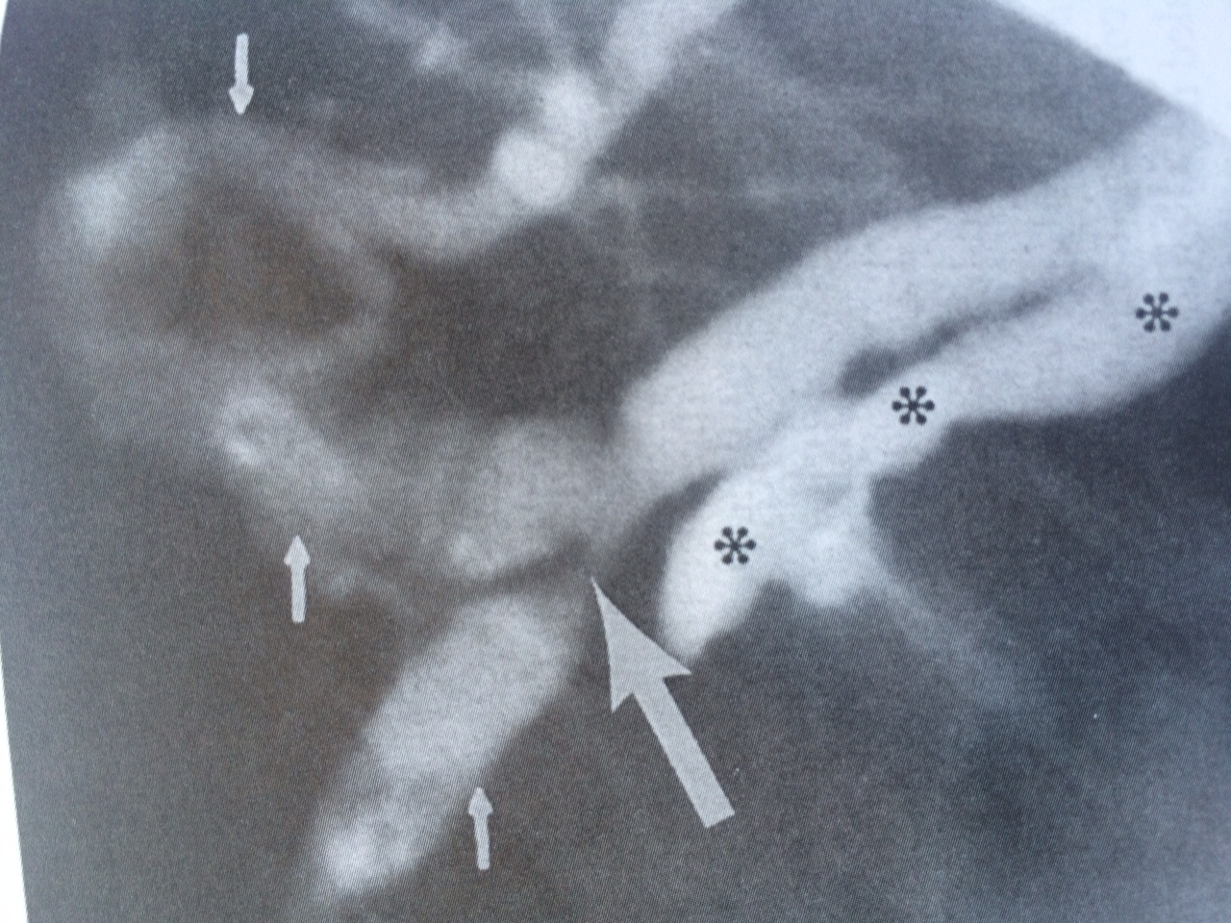
Diagnosis in Pediatrics
Imaging
Cholangiography remains the gold standard

Slide 10
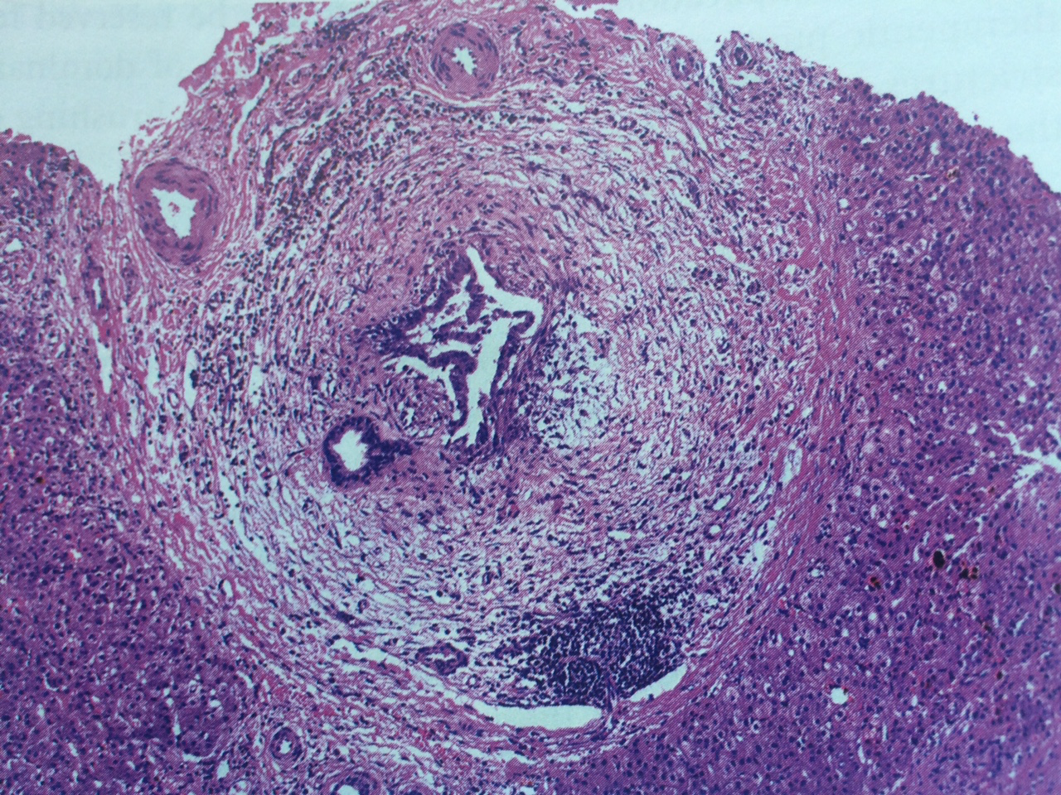
Diagnosis in Pediatrics
Supported by clinical signs and symptoms, laboratory data, and characteristic liver histology

Slide 11
Pediatric Inflammatory Bowel Disease
Crohn’s disease, Ulcerative colitis and IBDU
Chronic remitting and relapsing inflammatory conditions involving the GI tract
Disease defined by location, subtype, and extra-intestinal manifestations

Slide 12
Pediatric IBD and PSC
Can occur concurrently or independent
Symptoms of liver disease may precede, present together or follow the diagnosis of bowel disease
More commonly associated with UC
No direct correlation between bowel activity and liver activity
Symptomatic PSC and Quiescent IBD

Slide 13
Risk factor – Chronic minimally symptomatic pancolitis may predispose to developing UC
Explain to families to support medication adherence and compliance
PSC may serve as a surrogate marker for chronic, aymptomatic UC
We screen all of our newly diagnosed PSC patients for UC
In adults, the combination predicts a more complicated course of UC disease

Slide 14
Therapeutics
Goals of therapy
Provide symptomatic relief
Pruritus, nutrition, pain
Improve biliary drainage
Dilation, Stent, Cholerectics
Prevent/recognize complications
Cancer, infection, stricture, cirrhosis
Decrease progression

Slide 15
Choleretics
Ursodeoxycholic Acid (UDCA) – Ursodiol
Most widely used and studied
Inconclusive studies
Recent large long term randomized double blind studies resulted in the American Association for the Study of Liver Diseases in their 2010 guidelines advised AGAINST the use of UDCA in PSC

Slide 16
Immunosuppressants
Multiple have been explored
Tacrolimus
Mycophenylate
Cyclosporine
Corticosteroids
Azathioprine
Methotrexate
Monotherapy has not been successful, combination regimens may hold promise

Slide 17
Antibiotics
Minocycline
Metronidazole
Vancomycin

Slide 18
Vancomycin
125mg or 250mg by mouth three times a day
Led to biochemical improvement
improvement of alkaline phosphatase, GGT, and ESR
Improvement of clinical symptoms
Concerns: Selection of vancomycin resistant enteric organism

Slide 19
Potential Directions
Novel targets
Nuclear receptors
Bile acid metabolism
Monoclonal antibodies
Combination therapy

Slide 20
Nuclear receptors
Farnesoid X receptor
key role in bile acid homeostasis by regulation of genes involved in bile acid synthesis, secretion, conjugation, transportation, absorption, and detoxification
FXR agonists could be of therapeutic benefit in patients with cholestatic liver diseases
phase II clinical trial of an FXR agonist in PSC patients is ongoing
ClinicalTrials.gov Identifier: NCT02177136

Slide 21
Bile acid metabolism
Abnormal bile acid pool composition is thought to play a key role in the pathogenesis and progression of PSC
phase II clinical study evaluating the safety and efficacy of LUM001, an ASBT inhibitor, in patients with PSC is ongoing
ClinicalTrials.gov Identifier: NCT02061540

Slide 22
Monoclonal antibody
Vascular adhesion protein 1 (VAP-1) has been found to induce the expression of MAdCAM-1 in the hepatic endothelial cells of human liver tissue. This, in turn, was associated with increased adhesion of lymphocytes from patients with PSC
The VAP-1-blocking agent, BTT1023, is currently being investigated in a phase II clinical trial in patients with PSC
ClinicalTrials.gov Identifier: NCT02239211

Slide 23
Monocolonal antibody
Lysyl oxidase-like protein 2 (LOXL2) belongs to the lysyl oxidase family and has been shown to contribute to progressive liver damage in experimental models
Simtuzumab, a monoclonal antibody against LOXL2, is currently being investigated in a phase II clinical trial in patients with PSC
ClinicalTrials.gov Identifier: NCT01672853

Slide 24
Progression
Rate of progression in childhood PSC is unknown
Varying rates of transplantation seen in this age group (20-50%)
Negative predictors
Signs of advanced end stage liver disease
Older age
Positive predictors
Small duct PSC

Slide 25
Post transplant prognosis
Post transplant survival in adults with PSC is good
One year survival 84-97%
Recurrence of PSC disease in transplanted organ ranges from 10-20% in adult studies
Pediatric series of 11 patients
PSC recurred in 3 patients
Pediatric Liver Transplant Registry
9.8% recurrence rate after transplant at 18 months

Slide 26
PSC and IBD
PSC – cholangiopathy that can presents as an independent entity and commonly in association with IBD
A diagnosis of PSC should led to at least a screening for underlying IBD, as well a knowledge of (for the patient or family) that IBD may develop in the future
Currently no medication that halts the progression of PSC, however several on going trials show promise

Slide 27
Collaborative work
Groups like PSC Partners need to encourage prospective controlled collaborative trials to better define:
Natural history in pediatrics
Etiological studies in pediatrics
Link to other diseases like IBD

Slide 28
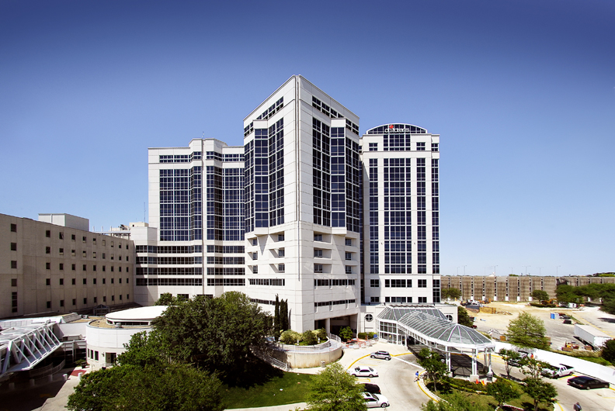
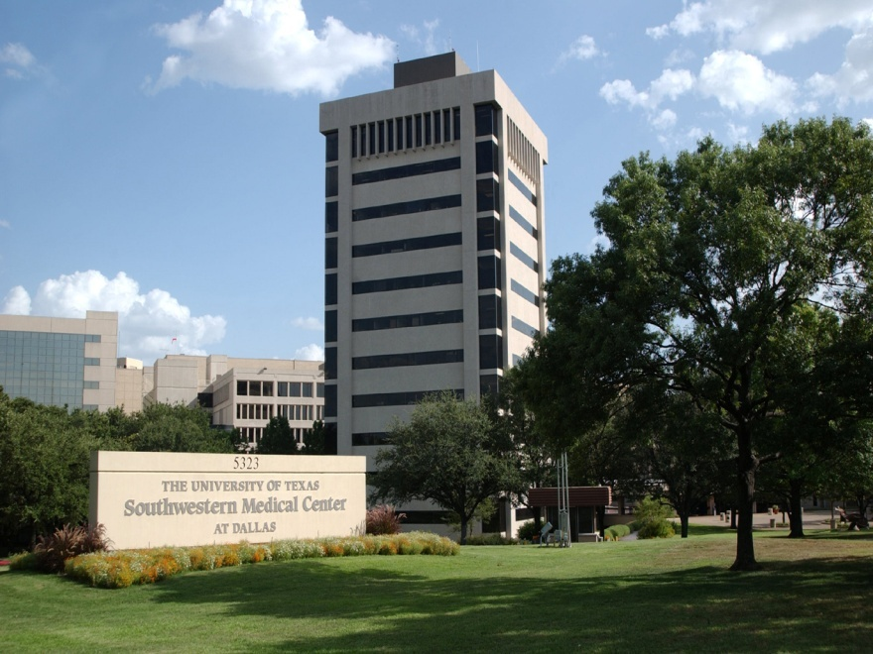
Thank you for your attention
Questions?

