Slide 1
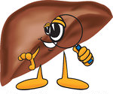
PSC Partners Seeking a Cure Annual Conference 2015 Pruritus in Primary Sclerosing Cholangitis
Caitriona Ryan MD FAAD MRCPI
Vice Chair, Department of Dermatology,
Baylor University Medical Center, Dallas
Clinical Associate Professor, Texas A+M Health Science Center

Slide 2
Outline
What is pruritus?
What causes pruritus in PSC?
How does this manifest in PSC?
What can be done to manage pruritus in PSC?

Slide 3
Outline
What is pruritus?
What causes pruritus in PSC?
How does this manifest in PSC?
What can be done to manage pruritus in PSC?

Slide 4
Pruritus = Itch
Definition: pruritus is a poorly localized, usually unpleasant sensation which elicits a desire to scratch
Perceived sensation of pruritus can be burning, pricking, insects crawling on the skin, or tickling
Can originate in the epidermis of skin or in the CNS
It is the dominant symptom of skin disease eg eczema, psoriasis (~85%)
10-50% may be secondary to underlying systemic disease ie no primary dermatosis
Lack of primary skin lesions suggests systemic cause of pruritus
Stäner et al. Acta Derm Venereol 2007
Notes:
Insects crawling

Slide 5
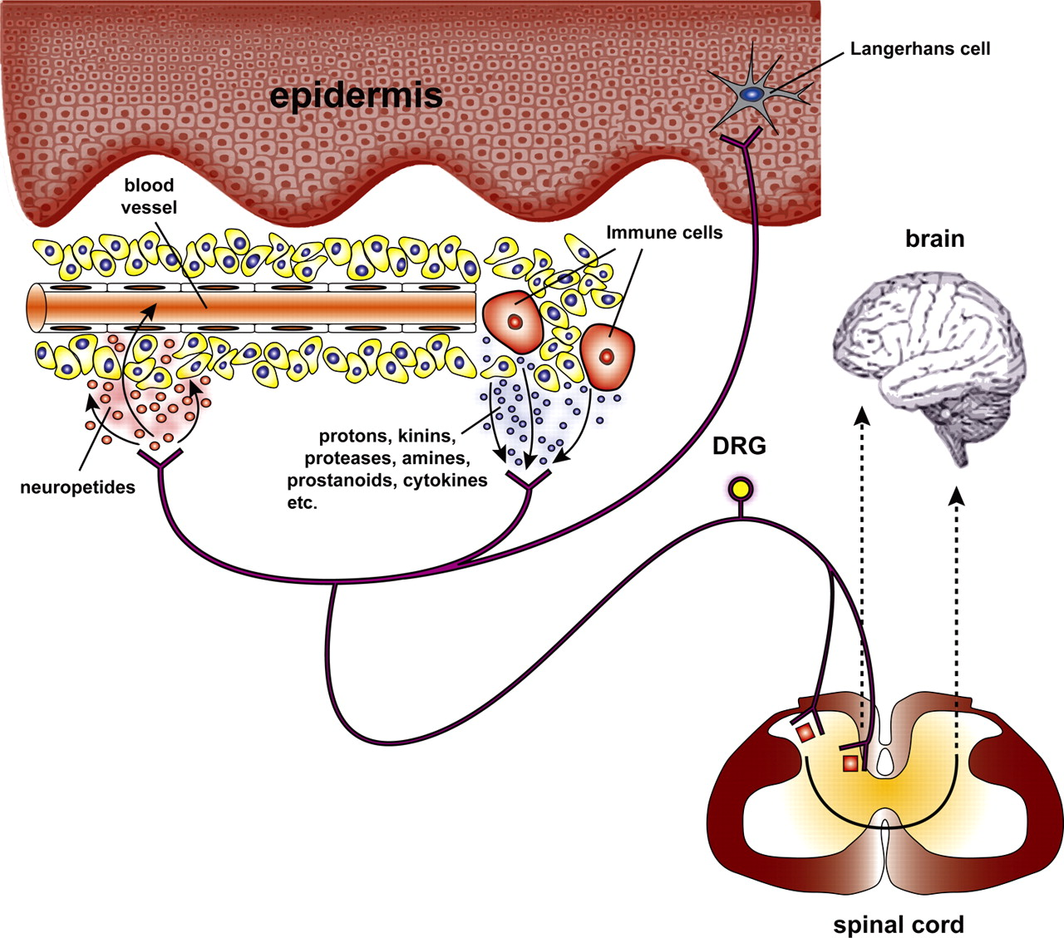
What is pruritus?
Raising the temperature of skin
lowers the threshold of receptors to
pruritogenic stimuli
Itch in skin disease is transmitted by individual
histamine-sensitive small unmyelinated C fibers
Other non-histamine-mediated C fibers (95%) are involved in the sensation of itch - this is why anti-histamines are mostly ineffective for most types of pruritus
Stäner et al. Acta Derm Venereol 2007

Slide 6
Outline
What is pruritus?
What causes pruritus in PSC?
How does this manifest on the skin?
What can be done to manage pruritus?

Slide 7
Causes of pruritus in PSC
Likely multifactorial – several theories
Previously thought to be caused by bile acids
cutaneous injection of bile acids can induce pruritus BUT
1. elevated bile acids not always associated with pruritus
2. spontaneous cessation of pruritus in liver failure
Opioid peptides:
Elevated CNS opioid peptide levels, down-regulation of opioid peptide CNS receptors,
patients respond to µ-opioid antagonists
Bergasa NV, J Hepatol 2005; Raiford DS. QJM 1995; Wolfhagen FH et al. Gastroenterology 1997; Bergasa NV et al. Ann Intern Med 1995
Notes:
Raiford DS. QJM 1995

Slide 8
Causes of pruritus in PSC
Cholestasis-related changes in the opioid system
may lead to changes in serotoninergic neurotransmission
Recent evidence that lysophosphatidic acid, a neuronal activator, may have a role in cholestatic pruritus
Possibly yet unknown pruritogen produced in the liver and excreted in the bile, which accumulates in the plasma as a result of cholestasis ?
Kremer et al. Gastroenterology 2010
Notes:
Kremer et al. Gastroenterology 2010

Slide 9
Other causes of pruritus in PSC
Co-existing dermatological conditions eg eczema, psoriasis
Drugs
Pruritus of aging
Impaired barrier function
Skin aggravated in winter/cold/dry weather
Changes in stratum corneum pH (alkaline), temperature and humidity trigger C fibers to transmit itch sensation
Heat usually aggravates pre-existing pruritus
Stress and anxiety may enhance itching

Slide 10
Outline
What is pruritus?
What causes pruritus in PSC?
How does this manifest in PSC?
What can be done to manage pruritus in PSC?

Slide 11
Clinical manifestations of pruritus
Itch can be an early symptom that develops years before other manifestations
Generalized, migratory and not relieved by scratching
Typically worse on the hands, feet and body regions constricted by clothing
Most pronounced at night ➔ interferes with sleeping
Secondary skin lesions - excoriations, ulcers, lichenification, hyperpigmentation

Slide 13
Excoriations

Slide 14
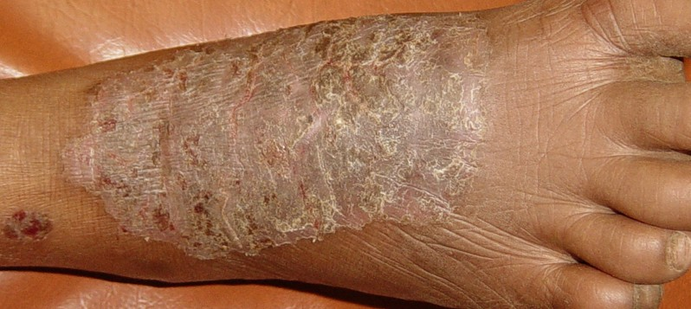
Lichen Simplex Chronicus

Slide 15
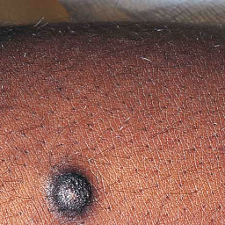
Prurigo Nodularis

Slide 16
Xerosis (dryness)

Slide 17
Outline
What is pruritus?
What causes pruritus in PSC?
How does this manifest on the skin?
What can be done to manage pruritus in PSC?

Slide 18
Management
General skin care:
Ceramide-containing emollients – moisturize, moisturize, moisturize!!!!
Short tepid baths/showers – avoid hot water!
Avoid alkaline soaps
Topical steroids not effective
Antihistamines have limited therapeutic benefit except for their sedating properties
Ultimately, liver transplantation for end-stage liver failure will improve symptoms

Slide 19
Management of Cholestatic Pruritus
Benefit confirmed in controlled clinical trials
Cholestyramine | 4–16 g po daily
Ursodeoxycholic acid | 13–15 mg/kg po daily
Rifampin | 300–600 mg po daily (depending upon serum bilirubin level)
Naltrexone | 25 mg po twice daily [day 1], then 50 mg po daily
Naloxone | 0.2 microg/kg/min iv infusion preceded by 0.4 mg iv bolus
Nalmefene | 2 mg po twice daily [day 1], 5 mg po twice daily [day 2], 10 mg po twice daily [day 3], then 20 mg po twice daily; increase as needed to maximum of 120 mg po twice daily
Propofol | 10–15 mg iv (bolus), 1 mg/kg/h (infusion)
Thalidomide | 100 mg po daily
Equivocal effect in controlled studies
Ondansetron |  | 4–8 mg iv or 8 mg po daily
Ghent CN et al, Gastroenterology 1988; Wolfhagen FH et al. Gastroenterology 1997; Bergasa NV et al. Ann Intern Med 1995; Bergasa et al. J Am Acad Dermatol 1999; Borgeat A et al, Gastroenterology 1993; McCormick PA et al. J Hepatol 1994; Muller C et al. Eur J Gastroenterol Hepatol 1998
Notes:
Ghent CN et al. Gastroenterology1988; Wolfhagen FH et al. Gastroenterology 1997; Bergasa NV et al. Ann Intern Med 1995; Bergasa et al. J Am Acad Dermatol 1999; Borgeat Aet al, Gastroenterology 1993; McCormick PA et al. J Hepatol 1994; Muller C et al. Eur J Gastroenterol Hepatol 1998

Slide 20
Management of Cholestatic Pruritus
Benefit observed in case series or case reports
Dronabinol | 5 mg po nightly
Sertraline | 75 mg po daily
Paroxetine | 10 mg po daily
Butorphanol spray | –
Plasma perfusion (ion resin BR-350) | –
Phenobarbital | 2–5 mg/kg po daily
Phototherapy: UVA, UVB | –
Stanozolol | 5 mg po daily
Walt et al, Br Med J 1988; Bergasa NV et al, Am J Gastroenterol 2001
Notes:
Walt et al, Br Med J 1988; Bergasa NV et al, Am J Gastroenterol 2001

Slide 21
