Slide 1
Fecal Microbiota Transplantation:
Cure for C.difficile Infection
Apurva Trivedi, MD
Gastroenterologist
Scott and White Memorial Hospital
Temple, TX

Slide 2
Outline
C. difficile infection
Fecal microbiota
Fecal microbiota transplant
Possible role in ulcerative colitis and primary sclerosing cholangitis

Slide 3
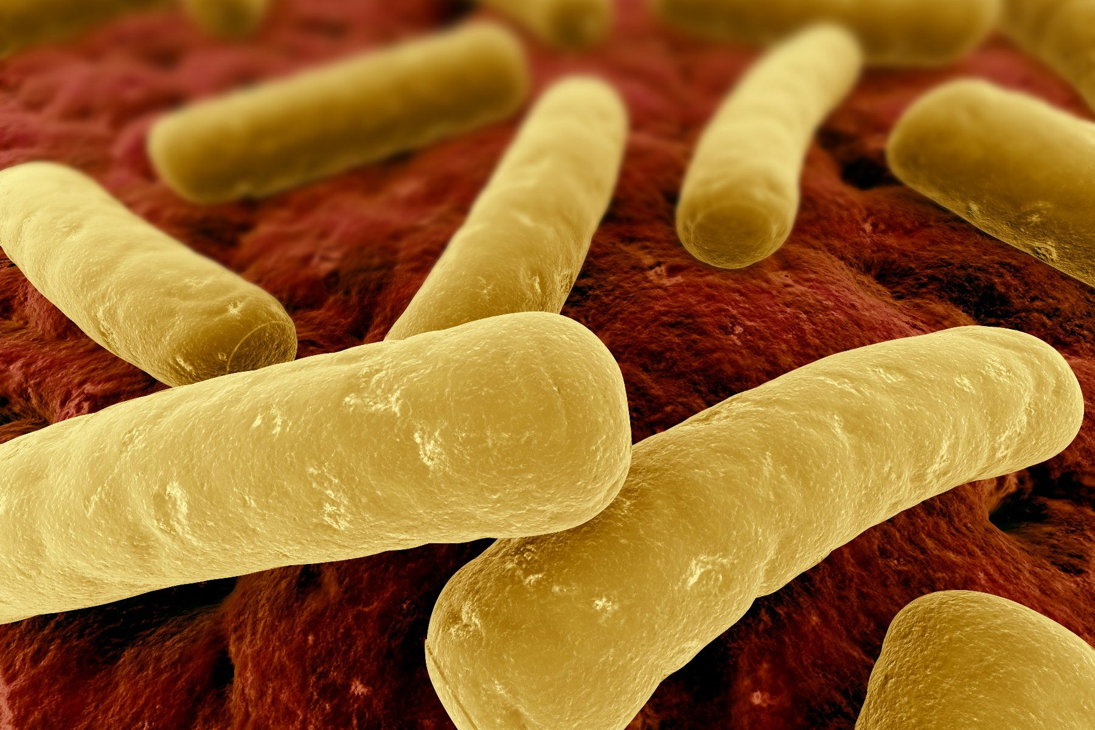
What is C. difficile?
Anaerobic gram-positive spore-forming toxin-producing rod-shaped bacteria
Colonizes the large intestine (colon)

Slide 4
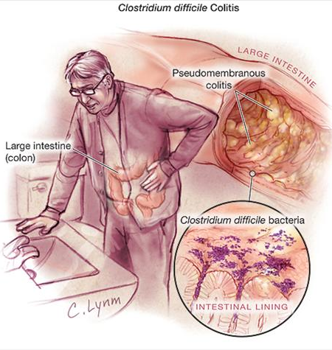
What is C.difficile colitis?
Presentation:
  Typically recent antibiotic exposure for infection (sinus infection, UTI, cholangitis, pneumonia)
  Abdominal pain
  Fevers
  Diarrhea, can be bloody
  Dehydration

Slide 5
CDI Basics
Infection is transmitted by spores that are resistant to heat, acid, antibiotics, most surface cleaners
Spores present in the soil, foods, and in high levels in hospitals
Transmitted by fecal-oral route
Release of exotoxins (TcdA, TcdB) causes colitis.
Most frequent type of hospital-acquired infection
>450,000 cases/year → leads to nearly 30,000 deaths per year
Previously an infection acquired in the hospital, now more that ¼ are community acquired
Hospital-acquired infection leads to increased healthcare cost → $1.5 billion dollars per year

Slide 6
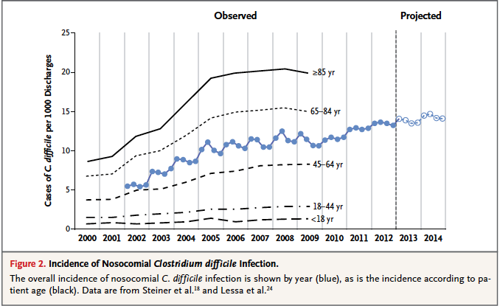
Increasing Problem

Slide 7
CDI Outcomes
Infection related mortality is 5% and all cause mortality of 15-20%.
Severe infection with high WBC, kidney injury, low albumin is an independent predictor of death, colectomy

Slide 8
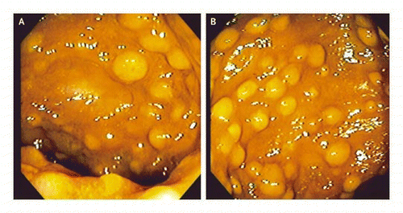
CDI Diagnosis
Diarrhea
Stool testing for toxin or toxin-producing DNA
Sigmoidoscopy

Slide 9
Recurrent CDI
Oral antibiotics to treat CDI
  Metronidazole, Vancomycin → ~70-75% effective
  Fidaxomicin for Vancomycin failuer → 90% effective
  Recurrent CDI occurs in 20-60% of cases
  Cost $1500 to $3000 for V or F
Reexposure or reactivation of spores
Impaired immune system
Weakened colon barrier function

Slide 10
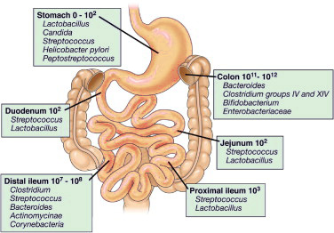
Normal Colonic Microbiota
Human colonic microbiota
  100 trillion bacteria (plus fungi, viruses)
  500-1000 different species
  60% of stool volume is bacteria
  Normally protects against invasive pathogens, infection,
  Produce vitamins
  Assist in digestion of non-digestible fiber
  Maintain colon health through production of free fatty acids
  Modulate the colonic immune system

Slide 11
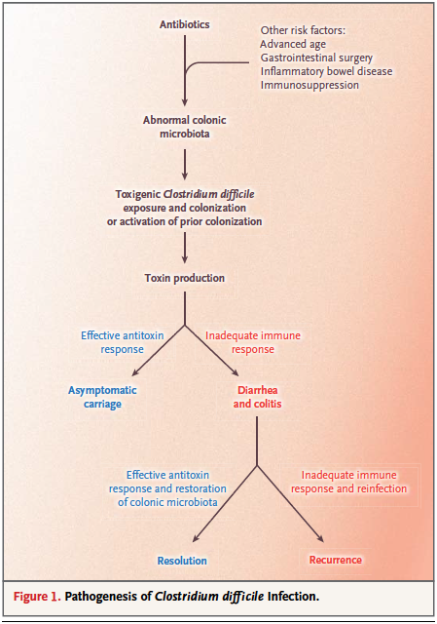
How do antibiotics cause infection?
At risk individuals:
  Advanced age, GI surgery, IBD, immunosuppression
Antibiotics destroy large populations of normal, commensal colonic bacteria that form a barrier against C.difficile colonization
Toxins produced by C.difficile destroy colon cells, cause colitis
C.difficile does not itself invade the colon lining.

Slide 12
C.difficile Infection (CDI)
Increasing numbers of infections
More aggressive, virulent strains developing
15/1000 hospitalizations in US
Antibiotics that trigger infection:
  Penicillins, cephalosporins, clindamycin, fluoroquinolones.

Slide 13
What is FMT?
Transfer of stool and bacteria from the colon of a healthy person to the colon of a person ill with a CDI

Slide 14
How Are Donors Screened?
Use same exclusions as for blood product donation
Screen donor for any illness – generally want someone who is healthy and on no medications
Screen for hepatitis A, B, C, HIV, H.pylori, syphilis, C.difficile, Giardia, E.coli, Salmonella, Shigella, Campylobacter infections
Can be an individual familiar to the patient or familiar to the MD

Slide 15
What is the process?
Stool is collected from the donor, processed to create a liquid suspension in water, filtered for large particulates
Stool can be frozen and used later with similar efficacy

Slide 16
How is the FMT Administered?
Small bowel upper endoscopy to the jejunum
Nasojejunal tube placement
Colonoscopy
Retention enemas
Oral capsules

Slide 17
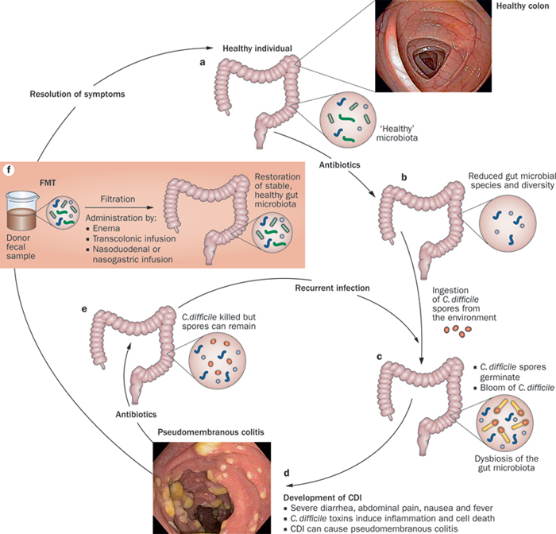

Slide 18
Results of FMT
Success rates depend slightly on route of delivery
Enema → 80-85%
Upper GI → 80-85%
Colonoscopy to the right colon → 90-95%
Usually see control of diarrhea symptoms within 48-96 hours

Slide 19
Risks of FMT
Risk of aspiration if not delivered deep into upper small intestine
Risk of acquiring infection from donors – rare, single case reports
Risk of complications from sedation and endoscopy – bleeding, perforation, transmission of other infections: 1/1000-1/10,000
DOES NOT IMPACT LIVER TRANSPLANTATION SCREENING OR STATUS

Slide 20
Studies Underway for IBD Treatment
Studies in IBD, IBS require intense regulatory oversight by the FDA.
Single study of 16 patients with IBD
  Improved frequency of flares – 63%
  Remission of flares over 21 months in 19%
  No increased risk of flares
  Average reduction in stool frequency from 8.2 to 3.6 per day
  Some patients able to stop IBD meds (25%)
CDI in IBD responds well to FMT (90% cure rate)

Slide 21
Studies Underway for IBS Patients
Small study showed 70% improvement in bloating, constipation, diarrhea in 13 IBS patients

Slide 22
FMT for PSC?
May help with control of associated UC
No studies on treatment of PSC reported or underway
Certainly has a role in treatment of CDI in PSC patients, pre-transplant, during transplant evaluation, and post-transplantation

Slide 23
Conclusions
CDI is a growing problem with severe consequences
Oral antibiotics are inferior to FMT for treatment of recurrent CDI
FMT is safe and effective for CDI and may play a role in controlling IBD and IBS
Currently all uses for FMT outside of CDI treatment are considered investigational and must take place in the setting of a clinical trial
FMT does NOT alter liver transplant status, may resolve recurrent infections that delay transplantation.

