Slide 1
How We “See” PSC: A Primer to Imaging Tests for PSC
Greg dePrisco, M.D.
4-25-15

Slide 2
What We’ll Cover
Why imaging is performed for patients with PSC
Compare and contrast ultrasound, CT, and MRI for evaluation of PSC
Patient preparation for these tests to achieve optimal images
Issues surrounding radiation and medical imaging

Slide 3
What We’ll Cover
Issues related to CT and MRI contrast
Specific issues related to MRI – claustrophobia and contraindications
The spectrum of PSC appearances on imaging tests
The role of percutaneous transhepatic cholangiography (PTC)

Slide 4
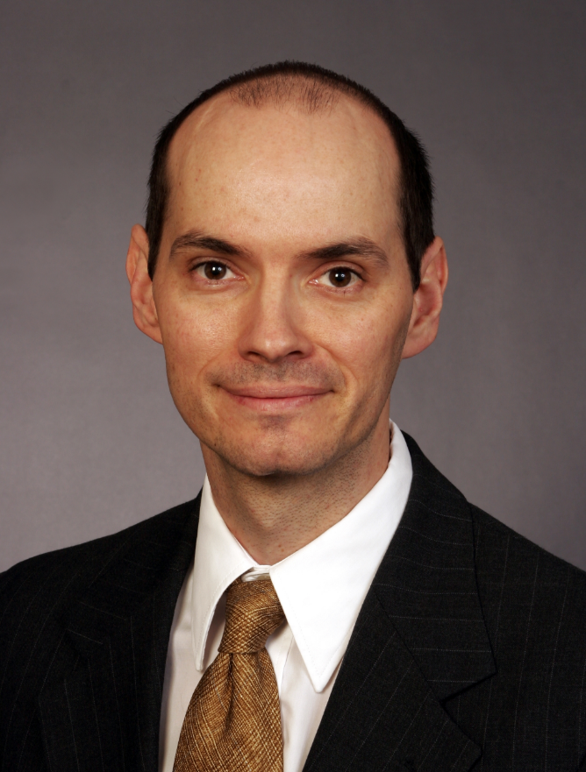
gregdeprisco@gmail.com
liverimager@gmail.com
horriblenarcissist@gmail.com

Slide 5
Disclosures (4)
Notes:
No disclosures

Slide 6


Slide 7
A show of hands…

Slide 8


Slide 9
Why imaging is performed for patients with PSC
Disease diagnosis
  PSC is diagnosed on the basis of characteristic imaging findings in conjunction with associated clinical, biochemical, serologic and histologic results
  In the past, diffuse intrahepatic and extrahepatic bile duct strictures were the cornerstone for diagnosis

Slide 10
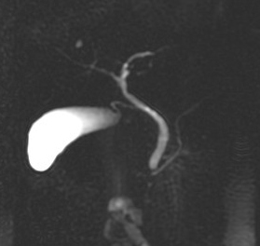
Normal MRCP
LHD
RHD
CHD
CD
PD
GB
CBD

Slide 11
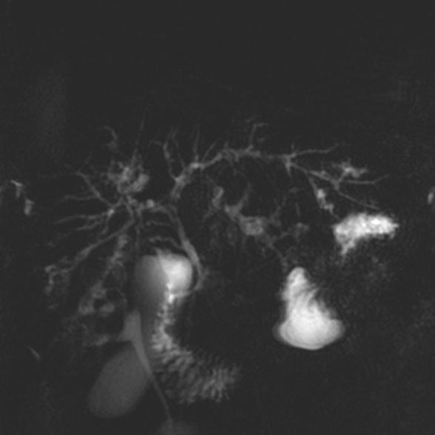
Primary Sclerosing Cholangitis

Slide 12
Why imaging is performed for patients with PSC
Caveats to the role of imaging for diagnosis
  Other disease processes and conditions that can result in “secondary cholangitis” must be excluded before diagnosing PSC
  Small duct variant of PSC (5-20% of cases) results in only intrahepatic strictures which may be occult on imaging

Slide 13
Why imaging is performed for patients with PSC
Detection of disease complications
  Progressive strictures
  Cirrhosis, portal hypertension
  Liver abscess
  Cholangiocarcinoma

Slide 14
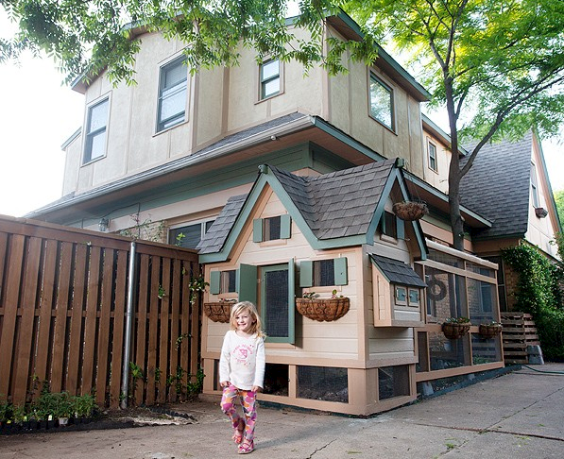

Slide 15
Ultrasound, CT, and MRI for evaluation of PSC

Slide 16
Ultrasound
Ultrasound is a fast, readily available test
If is usually the first test done in the setting of liver disease
It can readily detect bile duct dilatation, gallstones, and liver abnormalities
It involves no radiation
The exam can be limited by patient factors
It is operator dependent
Least expensive exam

Slide 17
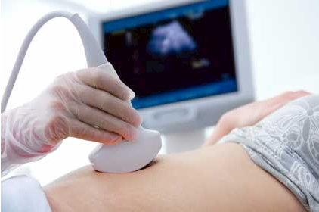

Slide 18
CT
CT is a fast, readily available test – the scan itself takes literally seconds
The exam is usually not limited by patient factors
It is not operator dependent
It involves radiation
Optimal study involves the use of iodinated intravenous contrast
More costly than ultrasound

Slide 19
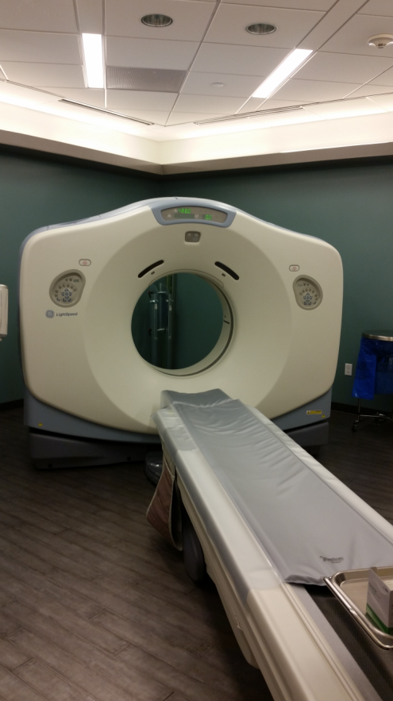
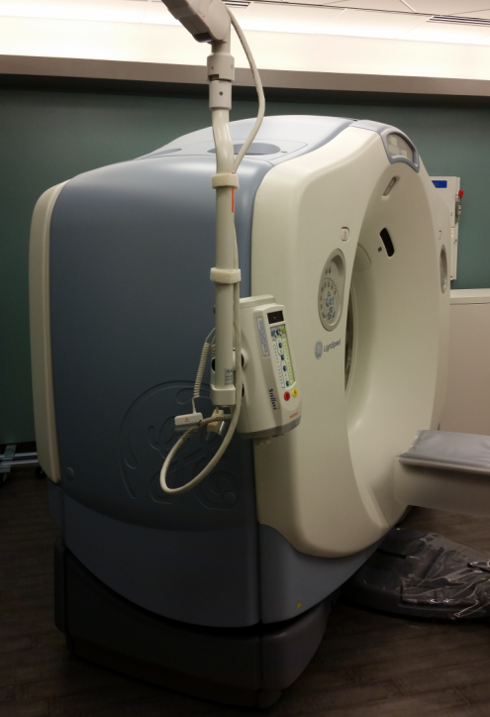
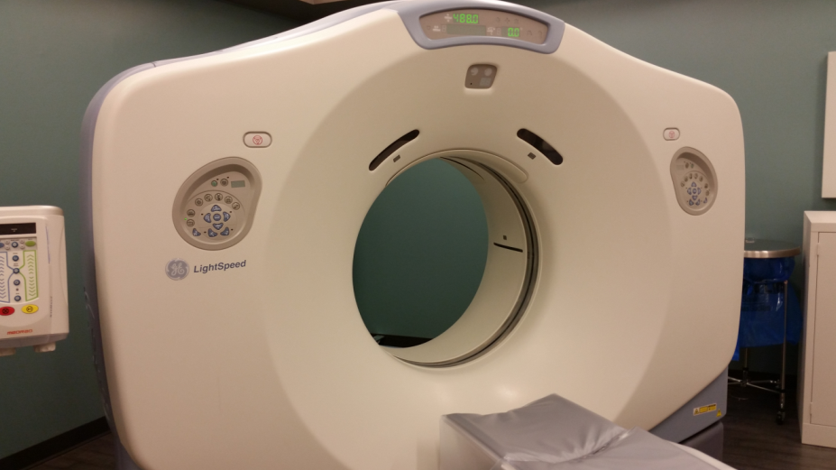

Slide 20
MRI
MRI is a more time consuming test, 30-60 mniutes
The exam may be limited by patient factors and artifacts
It is not operator dependent
It involves no radiation
Optimal study involves the use of gadolinium intravenous contrast
The most expensive exam

Slide 21
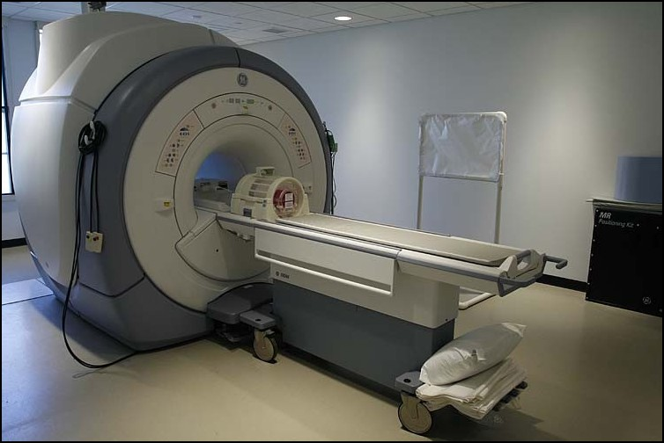
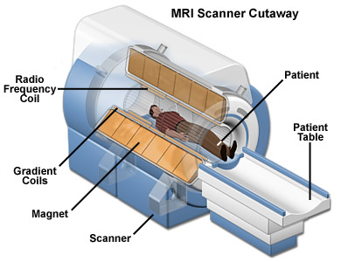
MRI

Slide 22
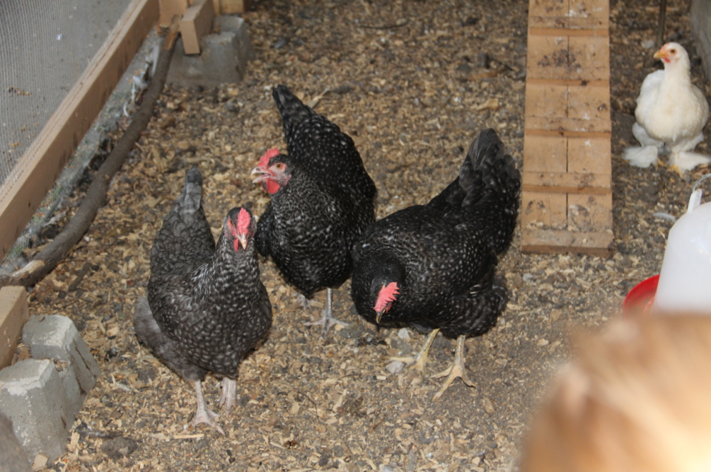

Slide 23
Patient preparation for imaging

Slide 24
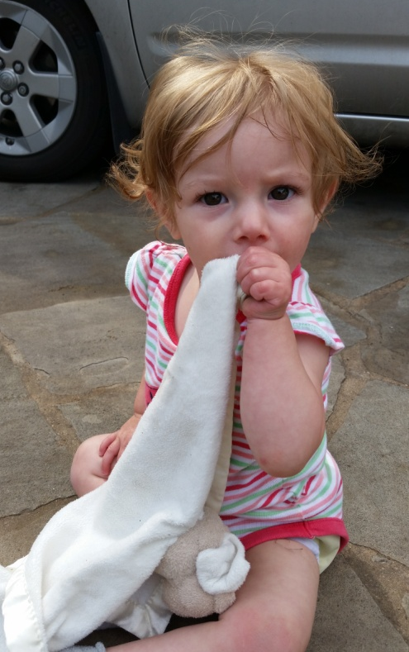
Relax!

Slide 25
Patient preparation for imaging
For all imaging exams, the patient has no intake of food or liquids by mouth for 4-6 hours prior to the exam – NPO
  For ultrasound to reduce the amount of gas in the abdomen and optimally evaluate the gallbladder
  For CT and MRI as intravenous contrast may be associated with nausea and cause vomiting

Slide 26
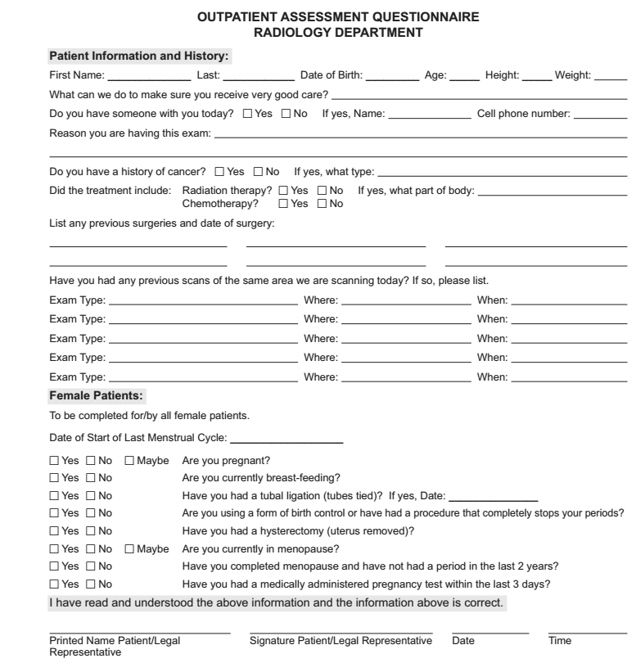

Slide 27


Slide 28
Issues surrounding radiation and medical imaging
CT utilizes ionizing radiation
The radiation can result in single strand breaks in DNA
Improperly healed DNA breaks can give rise mutations that can contribute to developing cancer

Slide 29
Issues surrounding radiation and medical imaging
Studies of atomic bomb survivors show survivors have an increase risk of developing malignancy
The dose of radiation given during CT is on a similar order of magnitude to that received by bomb survivors

Slide 30
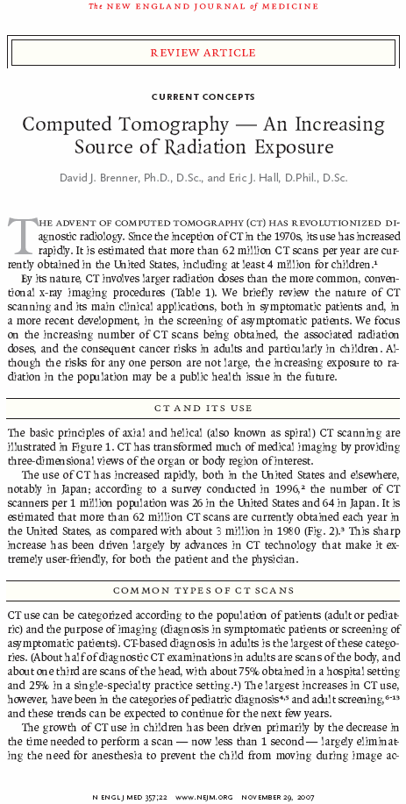
Issues surrounding radiation and medical imaging
Historically, the majority of radiation exposure has been due to background environmental radiation exposure, mainly radon
CT now rivals, and likely surpasses, environmental exposure

Slide 31
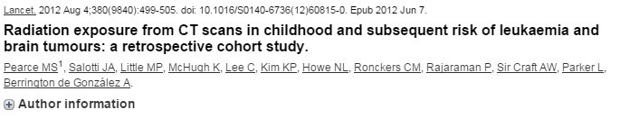
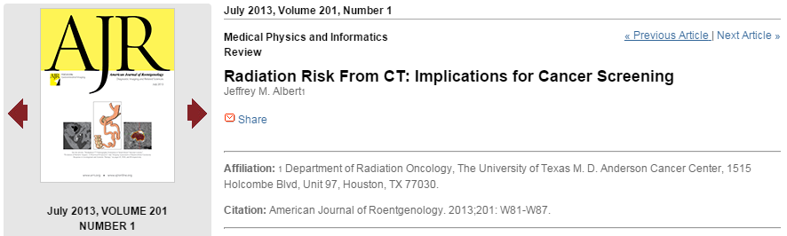
Issues surrounding radiation and medical imaging

Slide 32
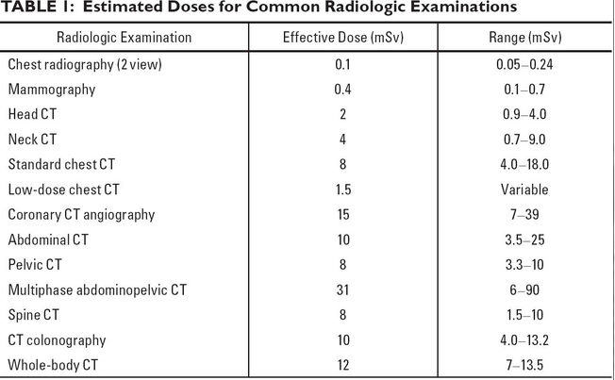
Issues surrounding radiation and medical imaging

Slide 33
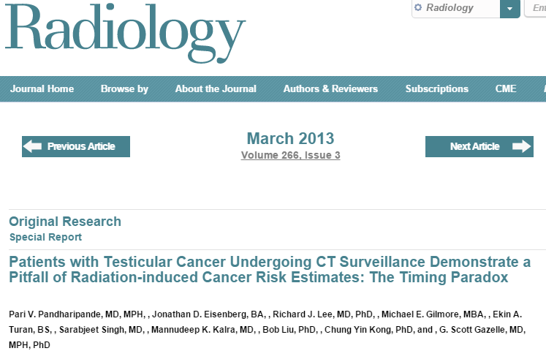
Issues surrounding radiation and medical imaging

Slide 34
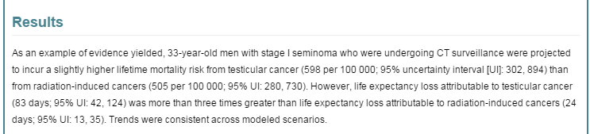
Issues surrounding radiation and medical imaging

Slide 35
Issues surrounding radiation and medical imaging
Take away points:
  The benefits of CT generally outweigh the risk when medical necessity dictates
  Utilization of MRI and ultrasound is preferable when feasible, especially for younger patients

Slide 36
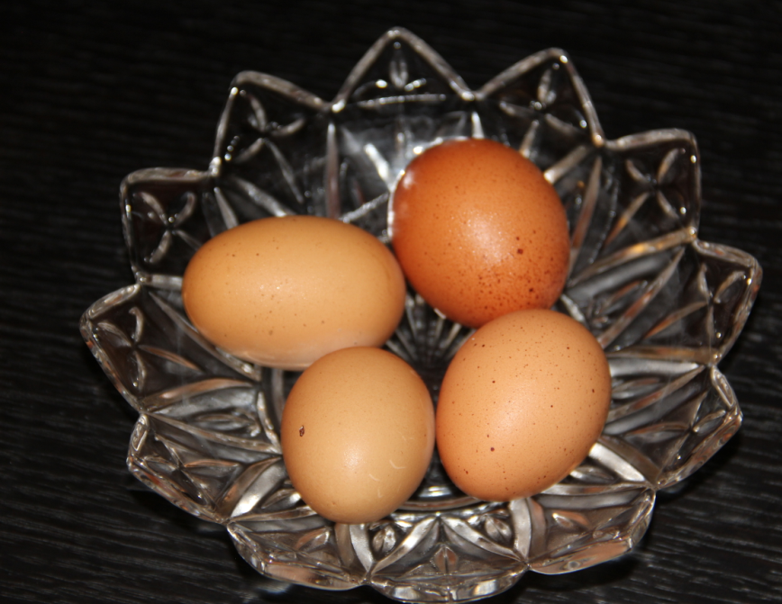

Slide 37
Issues related to CT and MRI contrast
Renal function is an important consideration prior to receiving CT or MRI contrast
CT contrast can impair renal function, possibly permanently and necessitate dialysis
MR contrast can give rise to a progressive disease, nephrogenic systemic fibrosis, which can be lethal

Slide 38
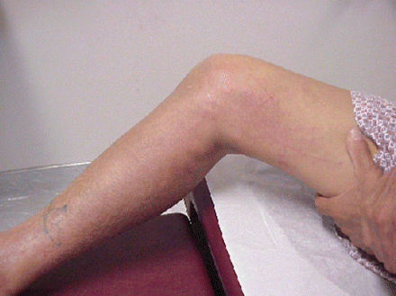
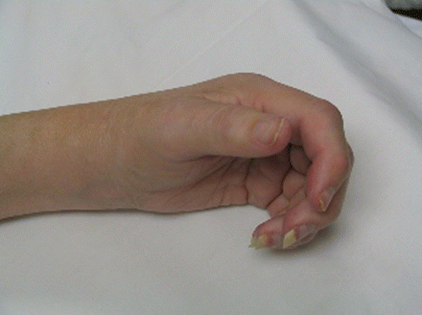
Nephrogenic systemic fibrosis,

Slide 39
Issues related to CT and MRI contrast
Contrast agents can cause allergic reactions
If one has had a prior minor reaction, premedication with steroids and benadryl prior to repeat contrast administration is undertaken and scanning is performed in a hosptial environment
If one has had a severe reaction, contrast is avoided

Slide 40
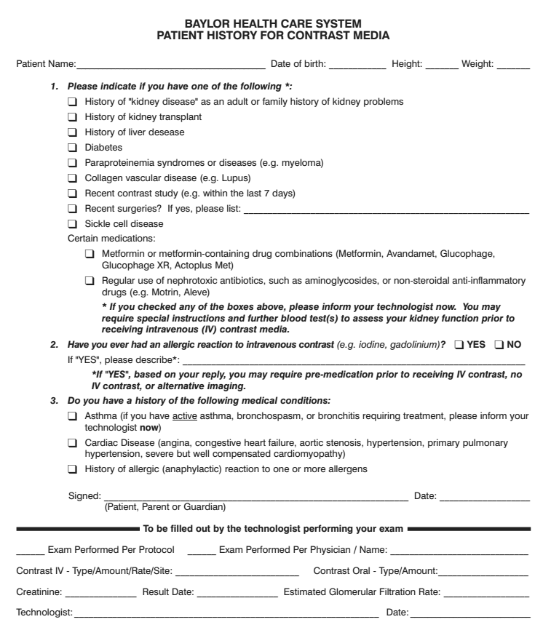

Slide 41
MRI specific issues

Slide 42
Claustrophobia
“Having an MRI is a lot like crawling under your bed while someone else sits on it banging pots and pans together.”

Slide 43
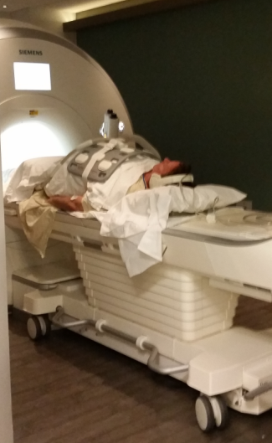
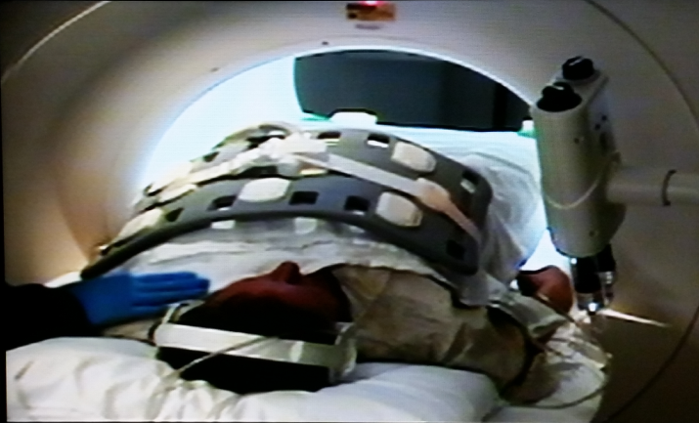
Claustrophobia

Slide 44
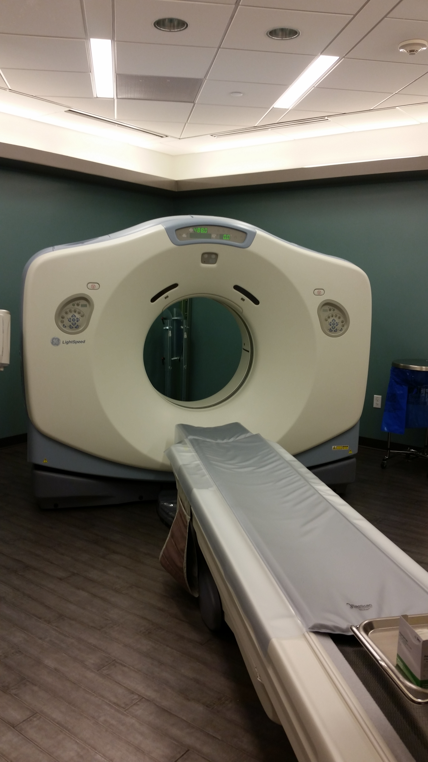
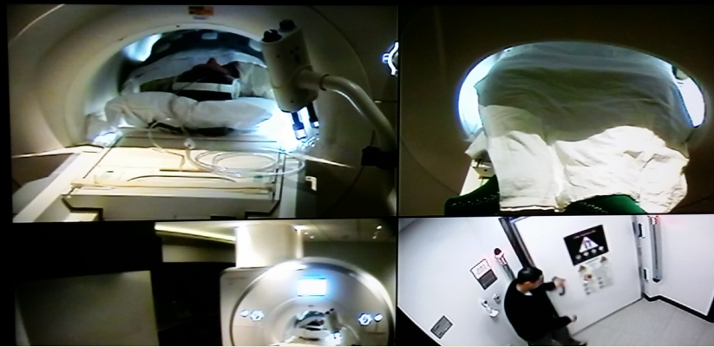
Claustrophobia

Slide 45
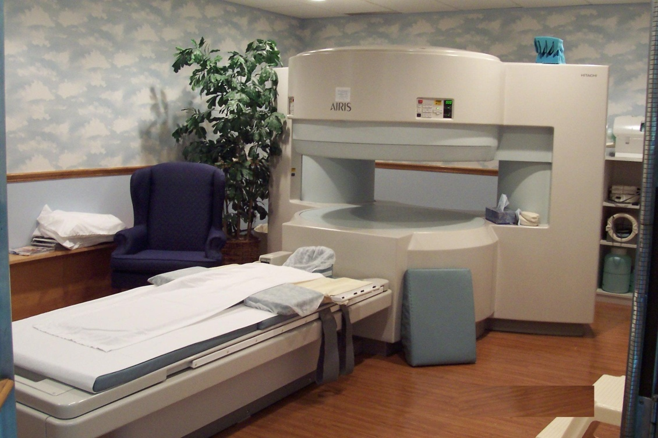
“Open” Magnets
Result in poorer images!

Slide 46
Claustrophobia
Light sedatives can be ordered by your doctor for you to take prior to the scan if you are claustrophobic
If taking a sedative, be sure to arrange for your safe transport home ahead of time!
If you are severely claustrophobic and other imaging modalities cannot answer the clinical question at hand, general anesthesia can be considered

Slide 47
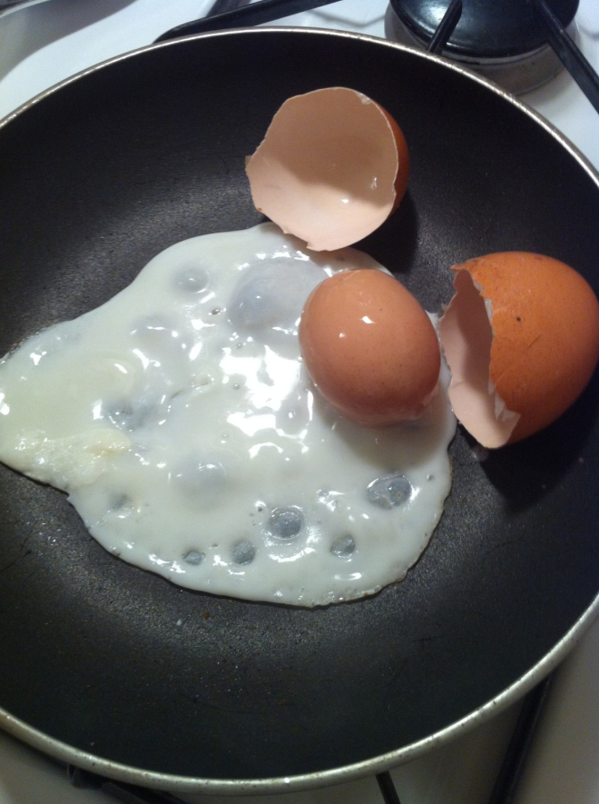

Slide 48
MRI contraindications
The magnet in an MRI scanner is incredibly powerful - about 10,000 times stronger than the magnetic field of the earth!
Retained metal and implanted devices are of particular concern

Slide 49
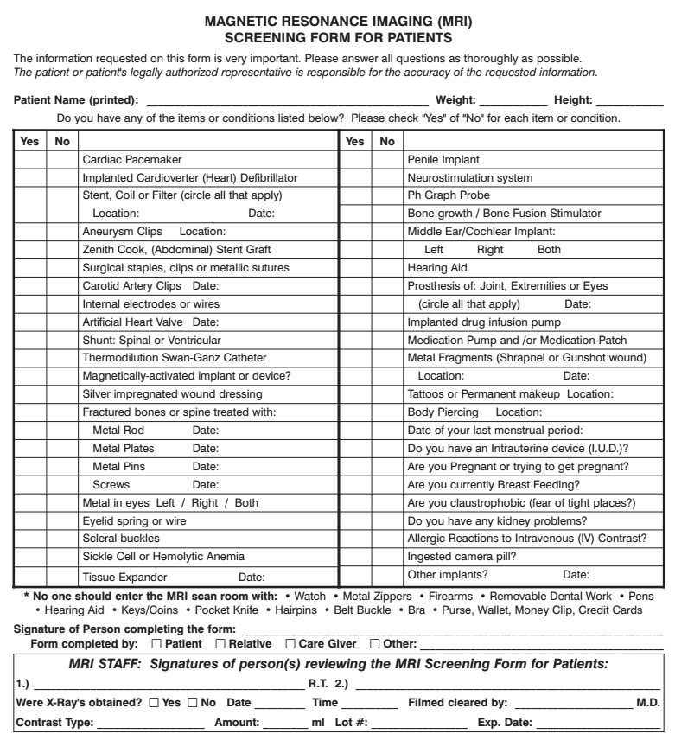

Slide 50
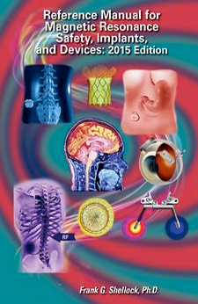
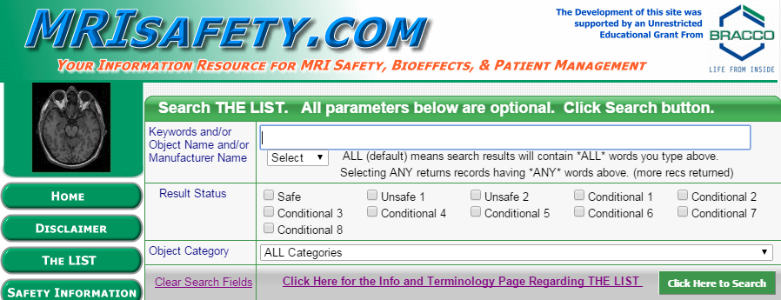

Slide 51
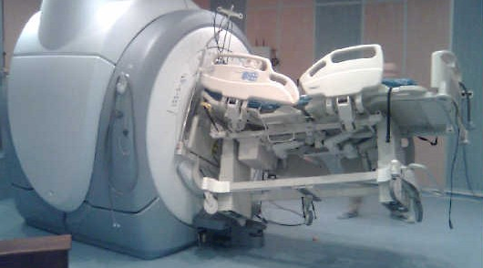
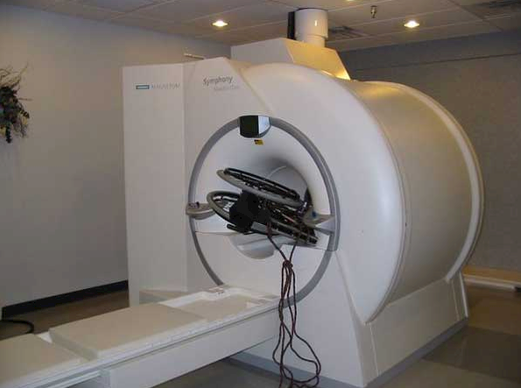
The magnet is ALWAYS on!

Slide 52


Slide 53
Spectrum of PSC appearances at imaging
We’ll begin with some normal anatomy

Slide 54
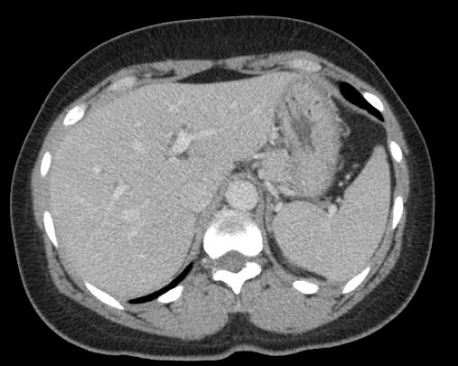
Stomach
IVC
AO
Liver
Spleen
Notes:
34
54

Slide 55
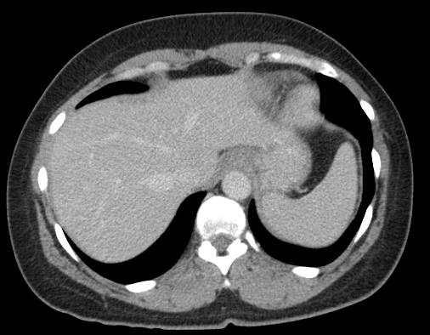
Left lobe
LHV
MHV
Right lobe
RHV
Notes:
25
55

Slide 56
HA
LPV
BD
RPV
Notes:
34
56

Slide 57
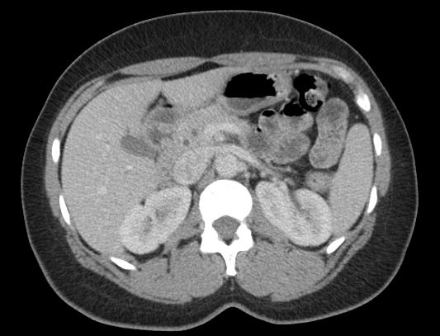
PD
CBD
Panc
GB
Duo
Notes:
50
57

Slide 58
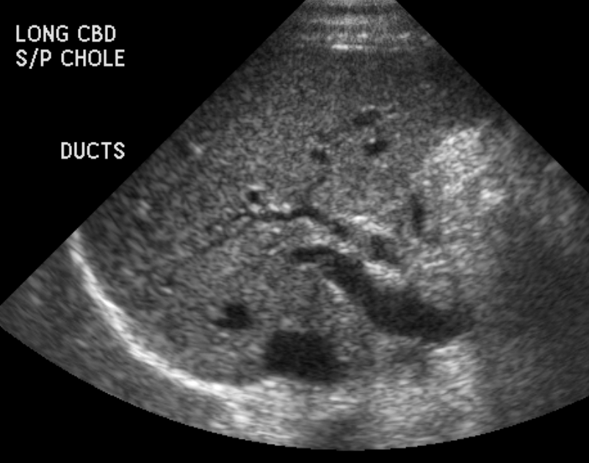
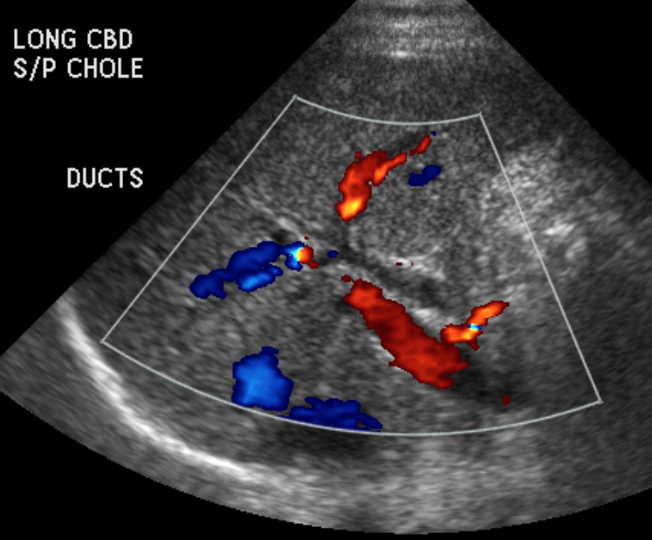
42 Year old female with abnormal liver function tests

Slide 59
Normal MRCP
LHD
RHD
CHD
CD
GB
CBD

Slide 60
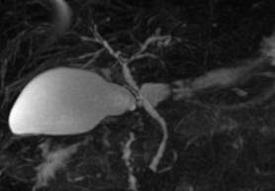
44 year-old male with PSC

Slide 61
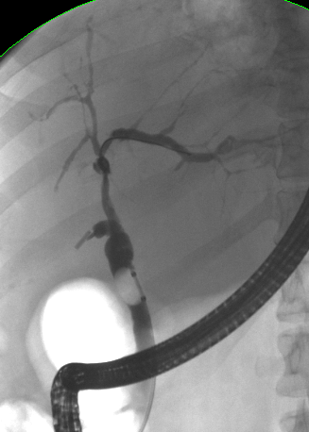
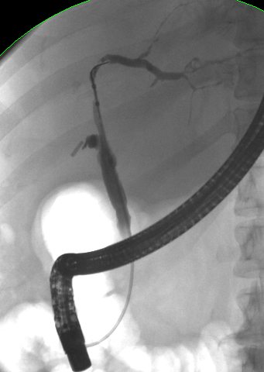
Similar early findings on ERCP

Slide 62
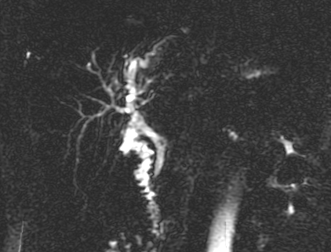
More pronounced changes of PSC

Slide 63
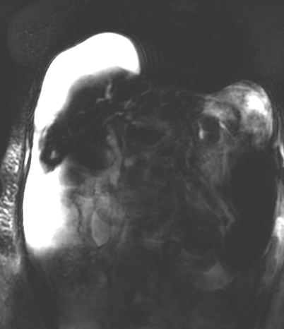
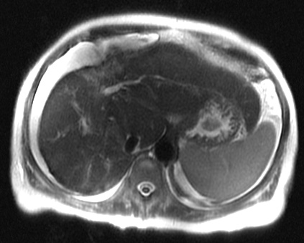
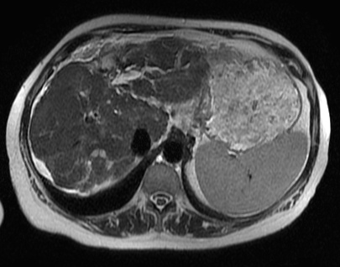
Disease progression over time
November, 2010
March, 2015
Notes:
11/2010 to 3/15

Slide 64
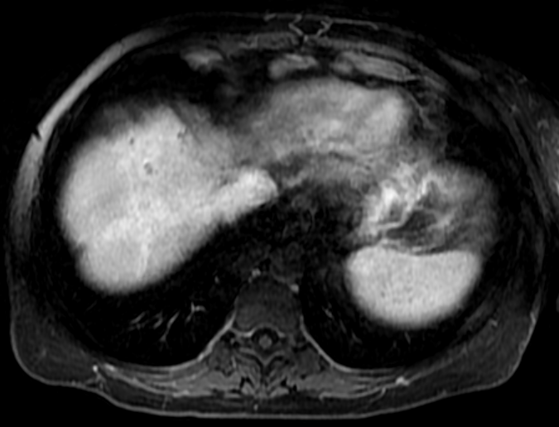
59 year-old female with PSC and
portal hypertension, varices

Slide 65
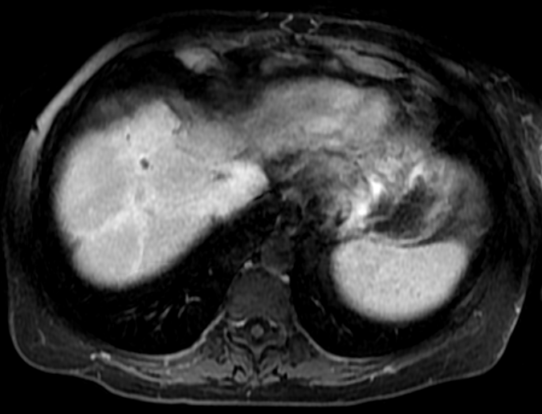
59 year-old female with PSC and
portal hypertension, varices

Slide 66
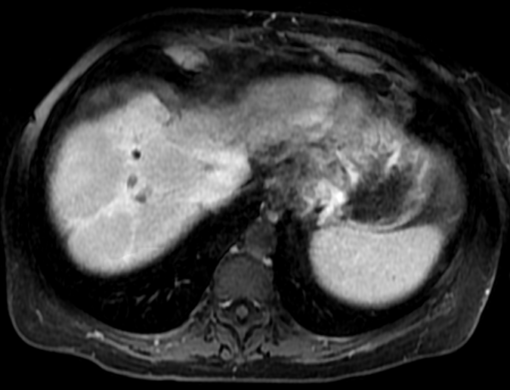
59 year-old female with PSC and
portal hypertension, varices

Slide 67
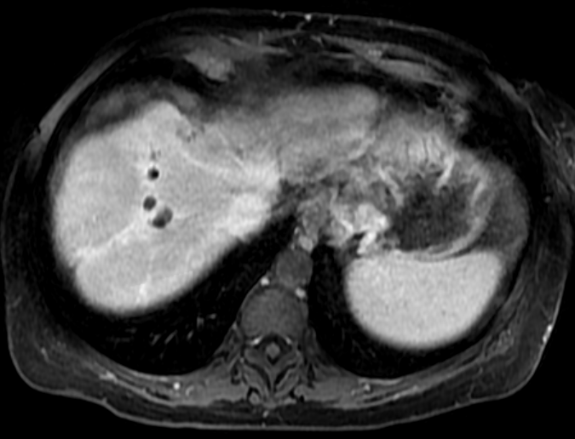
59 year-old female with PSC and
portal hypertension, varices

Slide 68

59 year-old female with PSC and
portal hypertension, varices

Slide 69

59 year-old female with PSC and
portal hypertension, varices

Slide 70

59 year-old female with PSC and
portal hypertension, varices

Slide 71

59 year-old female with PSC and
portal hypertension, varices

Slide 72

59 year-old female with PSC and
portal hypertension, varices

Slide 73

59 year-old female with PSC and
portal hypertension, varices

Slide 74

59 year-old female with PSC and
portal hypertension, varices

Slide 75

59 year-old female with PSC and
portal hypertension, varices

Slide 76

59 year-old female with PSC and
portal hypertension, varices

Slide 77

59 year-old female with PSC and
portal hypertension, varices

Slide 78

59 year-old female with PSC and
portal hypertension, varices

Slide 79

59 year-old female with PSC and
portal hypertension, varices

Slide 80


Slide 81


Slide 82
Cholangiocarcinoma
The feared complication of PSC
Occurs in about 10% of patients
Uncommon in the setting of small duct variant PSC

Slide 83
Cholangiocarcinoma
Suspected when there is clinical worsening - new jaundice, weight loss, worsening pruritus or rising serum marker such as CA19-9
Imaging tests are often complimentary for evaluation as these tumors are challenging to discover and may be occult on imaging!

Slide 84
Cholangiocarcinoma
Prior interventions like ERCP and past biopsies may confound diagnosis
Diagnosis typically depends on biopsy

Slide 85
Cholangiocarcinoma
Imaging appearance variable due to location and growth pattern
  Mass forming
  Intraductal
  Periductal infiltrating

Slide 86



Cholangiocarcinoma
  Appearance varies due to amount of fibrosis and necrosis
  Delayed enhancement due to fibrosis
Notes:
86

Slide 87

Cholangiocarcinoma
Notes:
87

Slide 88


Slide 89

45 year-old female with proven infiltrating cholangiocarcinoma

Slide 90

45 year-old female with proven infiltrating cholangiocarcinoma

Slide 91

45 year-old female with proven infiltrating cholangiocarcinoma

Slide 92

45 year-old female with proven infiltrating cholangiocarcinoma

Slide 93

45 year-old female with proven infiltrating cholangiocarcinoma

Slide 94

45 year-old female with proven infiltrating cholangiocarcinoma

Slide 95

45 year-old female with proven infiltrating cholangiocarcinoma

Slide 96

45 year-old female with proven infiltrating cholangiocarcinoma

Slide 97

45 year-old female with proven infiltrating cholangiocarcinoma

Slide 98

45 year-old female with proven infiltrating cholangiocarcinoma

Slide 99

45 year-old female with proven infiltrating cholangiocarcinoma

Slide 100

45 year-old female with proven infiltrating cholangiocarcinoma

Slide 101

45 year-old female with proven infiltrating cholangiocarcinoma

Slide 102

45 year-old female with proven infiltrating cholangiocarcinoma

Slide 103

45 year-old female with proven infiltrating cholangiocarcinoma

Slide 104

45 year-old female with proven infiltrating cholangiocarcinoma

Slide 105

45 year-old female with proven infiltrating cholangiocarcinoma

Slide 106

45 year-old female with proven infiltrating cholangiocarcinoma

Slide 107

45 year-old female with proven infiltrating cholangiocarcinoma

Slide 108

45 year-old female with proven infiltrating cholangiocarcinoma

Slide 109

45 year-old female with proven infiltrating cholangiocarcinoma

Slide 110

45 year-old female with proven infiltrating cholangiocarcinoma

Slide 111

45 year-old female with proven infiltrating cholangiocarcinoma

Slide 112

45 year-old female with proven infiltrating cholangiocarcinoma

Slide 113

45 year-old female with proven infiltrating cholangiocarcinoma

Slide 114

45 year-old female with proven infiltrating cholangiocarcinoma

Slide 115

45 year-old female with proven infiltrating cholangiocarcinoma

Slide 116

45 year-old female with proven infiltrating cholangiocarcinoma

Slide 117

45 year-old female with proven infiltrating cholangiocarcinoma

Slide 118

45 year-old female with proven infiltrating cholangiocarcinoma

Slide 119

45 year-old female with proven infiltrating cholangiocarcinoma

Slide 120

45 year-old female with proven infiltrating cholangiocarcinoma

Slide 121


Slide 122
Percutaneous transhepatic cholangiography (PTC)
An invasive procedure used for the evaluation of biliary disease that may be diagnostic and therapeutic
Useful when ERCP is nondiagnostic or precluded

Slide 123
Percutaneous transhepatic cholangiography (PTC)
Usually performed under general anesthesia
Complications of bleeding and infection may occur, requiring further procedures or antibiotic therapy

Slide 124

52 year-old male with early findings of PSC on PTC

Slide 125

48 YOM with advanced PSC, at ERCP right ducts poorly seen
?

Slide 126



48 YOM with advanced PSC, at PTC right ducts inolved

Slide 127

44 YOM male 3 years post liver transplant for PSC, bilirubin inc’d
Notes:
Recurrent PSC in transplant liver

Slide 128

44 YOM male 3 years post liver transplant for PSC, bilirubin inc’d
Notes:
Recurrent PSC in transplant liver

Slide 129


55 year-old male with PSC and intrahepatic stones

Slide 130

55 year-old male with PSC and intrahepatic stones

Slide 131
Percutaneous transhepatic drains
Therapeutic option when ERCP stenting has proven ineffective or when ERCP cannot be performed
Drains may be external or internal / external
Drains are typically checked and exchanged every 4-6 weeks

Slide 132
Percutaneous transhepatic drains
Drains tend to be more effective when there is one dominant stricture
Multiple drains can be placed, but care for drains and risk of complications increase when drains are numerous
Removable internal metallic stents may be placed in some cases

Slide 133

PSC with CHD fibrosis

Slide 134

PSC with intrahepatic periductal fibrosis

Slide 135


Slide 136
What We’ve Covered
The role of imaging in PSC
What you can do to get the best quality study
  – Relax! But don’t eat before your scan
Issues related to radiation and contrast exposure

Slide 137
What We’ve Covered
Caveats on claustrophobia and implanted devices / retained metal for MRI
Characteristic appearances of the natural history of PSC
The role of PTC and drainage tubes

Slide 138


Slide 139


Slide 140
Thank you!
Any questions?

Slide 142
Issues surrounding radiation and medical imaging
Absorbed radiation dose
  the amount of energy absorbed per unit mass
  Expressed in gray – Joules absorbed per kilogram of tissue J/Kg

Slide 143
Issues surrounding radiation and medical imaging
Equivalent radiation dose
  Absorbed dose multiplied by a unitless radiation weighting factor that accounts for differences in biological effectiveness between different types of radiation
  Expressed in sievert – J/Kg

Slide 144
Issues surrounding radiation and medical imaging
Effective radiation dose
  Equivalent dose multiplied by a unitless tissue weighting factor that accounts for inherent differences in tissue radiosensitivity and then summing these values for all specified tissues
  Expressed in sievert – J/Kg

