Slide 1
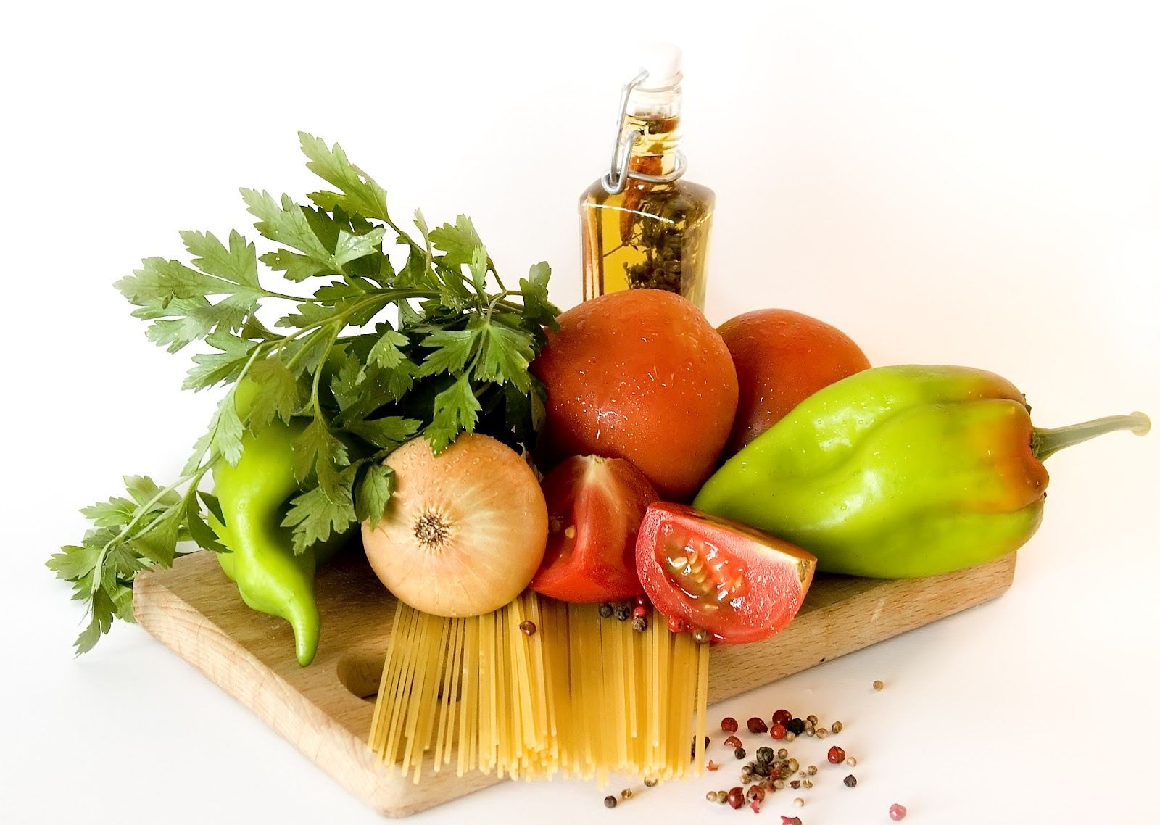
Nutrition & PSC: OK, Now What Do I Eat?
Jeanette Hasse, PhD, RDN, LD, FADA, CNSC
Baylor Simmons Transplant Institute
Baylor University Medical Center, Dallas, TX

Slide 2
Objectives
Discuss common vitamin deficiencies associated with PSC.
Suggest practical tips for making healthy food choices
Provide suggested nutrition resources.

Slide 3
Vitamin A
FUNCTION
SOURCE
Needed for vision, healthy skin and mucous membranes, bone and tooth growth, immune system health
Vitamin A from animal sources (retinol): fortified milk, cheese, cream, butter, fortified margarine, eggs, liver
Beta-carotene (from plant sources): Leafy, dark green vegetables; dark orange fruits (apricots, cantaloupe) and vegetables (carrots, winter squash, sweet potatoes, pumpkin
Supplementation

Slide 4
Vitamin D
FUNCTION
SOURCE
Needed for proper absorption of calcium; stored in bones
Involved in immune function
Egg yolks, liver, fatty fish, fortified milk, fortified margarine.
When exposed to sunlight, the skin can make vitamin D.
Supplementation

Slide 5
Vitamin E
FUNCTION
SOURCE
Antioxidant; protects cell walls
Polyunsaturated plant oils (soybean, corn, cottonseed, safflower)
Leafy green vegetables
Wheat germ; whole-grain products
Liver; egg yolks; nuts and seeds
Supplementation

Slide 6
Vitamin K
FUNCTION
SOURCE
Needed for proper blood clotting; helps with bone density
Leafy green vegetables and vegetables in the cabbage family
Milk
Also produced in intestinal tract by bacteria
Supplementation

Slide 7
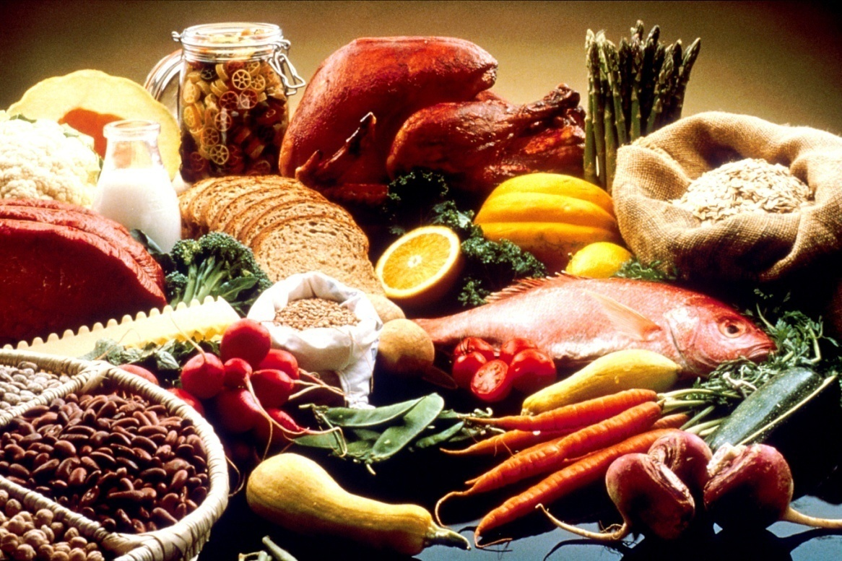
Eating Healthy
Variety
Moderation

Slide 8
Making Choices
Choose This | Not THat
Lean, low-fat foods | Fatty or greasy foods
Heart-healthy oils | Saturated or trans fat
High-fiber foods | Sugary foods
Low-sodium foods and seasonings | Salty foods and seasoning
Natural, unprocessed foods | Heavily processed foods
Moderate portions | Excessive portions
Clean, uncontaminated food | Unclean, contaminated food
Multivitamin | Herbal pills

Slide 9
Choosing Healthy Foods: Vegetables & Fruit
Food Group (Serving size) | Choose “Green Light” foods every day. | Choose “Yellow Light” foods once in a while. | Never choose “Red Light” foods!
Vegetables (1 cup raw or ½ cup cooked) | Fresh or frozen vegetables Vegetables canned without salt | Vegetables canned with salt Fried vegetables | Unwashed vegetables Uncooked bean sprouts
Fruits (1medium piece or ½ cup) | Fresh, frozen, or canned without sugar Fruit juice without added sugar | Fruit and juice with added sugar | Unwashed fruits Unpasteurized apple juice/cider

Slide 10
Choosing Healthy Foods: Grains
Food Group (Serving size) | Choose “Green Light” foods every day. | Choose “Yellow Light” foods once in a while. | Never choose “Red Light” foods!
Grains (1/2 cup) | Whole grain cereal, bread, crackers, pasta, and rice | White or refined cereal, bread, pasta, and rice

Slide 11
Choosing Healthy Foods:
Proteins
Food Group (Serving size) | Choose “Green Light” foods every day. | Choose “Yellow Light” foods once in a while. | Never choose “Red Light” foods!
Meats (3 to 4 ounces or size of a deck of cards) | Lean chicken, fish, turkey, beef, and pork Eggs (4 to 5 per week) and egg yolks Beans cooked without salt Unsalted Nuts | Fatty or fried meats Processed meat such as bacon, ham, sausage, hot dogs, lunch meat Canned beans or beans cooked with salt Salted nuts | Uncooked or under-cooked meat including sushi, ceviche, oysters Raw eggs Unpasteurized tofu that is not cooked.

Slide 12
Choosing Healthy Foods:
Dairy
Food Group (Serving size) | Choose “Green Light” foods every day. | Choose “Yellow Light” foods once in a while. | Never choose “Red Light” foods!
Milk (1 cup) | Skim or non-fat milk Non-fat yogurt Soy or almond milk | Whole milk Chocolate milk Ice cream | Unpasteurized milk or cheese

Slide 13
Choosing Healthy Foods:
Fats & Sweets
Food Group (Serving size) | Choose “Green Light” foods every day. | Choose “Yellow Light” foods once in a while. | Never choose “Red Light” foods!
Fats and oils | Olive or canola oil | Other oils
(1 teaspoon) | Trans-fat-free margarine | Butter, Margarine containing trans fat
 | Non-fat cooking spray | Lard, shortening, bacon fat
Sweets and desserts | Fresh, frozen, or canned fruit without sugar | Regular and sugar-free desserts
Beverages | Water | Soft drinks, fruit-flavored drinks, sports drinks | Alcohol, cooking wines Contaminated water

Slide 14
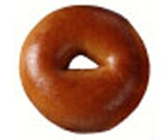

Bagel
20 Years Ago
Today
3-inch diameter
6-inch diameter
140 calories
350 calories
Guess the calorie difference!
210 calories!

Slide 15
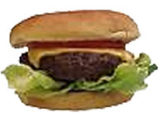

Cheeseburger
20 Years Ago
Today
330 calories
590 calories
Guess the calorie difference!
260 calories!

Slide 16
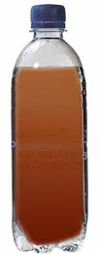

Soda
20 Years Ago
Today
6.5 ounces
20 ounces
80 calories
250 calories
Guess the calorie difference!
170 calories!

Slide 17
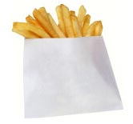
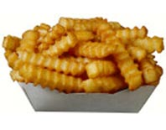
French Fries
20 Years Ago
Today
2.4 ounces
6.9 ounces
210 calories
610 calories
Guess the calorie difference!
400 calories!

Slide 18


Coffee
20 Years Ago
Today
Coffee, 8 ounces
(with whole milk & sugar)
Mocha coffee, 16 ounces
(with steamed whole milk
& mocha syrup)
45 calories
350 calories
Guess the calorie difference!
305 calories!

Slide 19
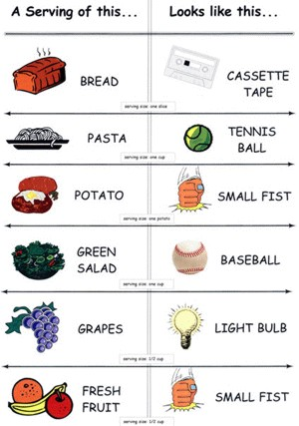
Portion Size

Slide 20
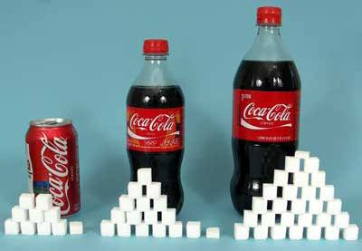
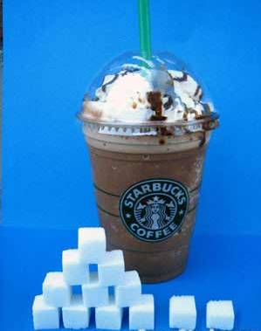
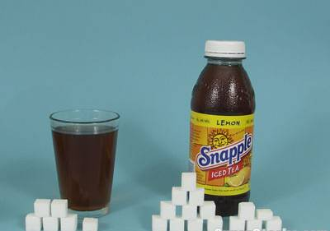
Choose Low-Sugar Foods
Limit to 32 g sugar/day (8 packets)

Slide 21
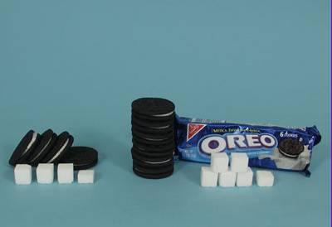
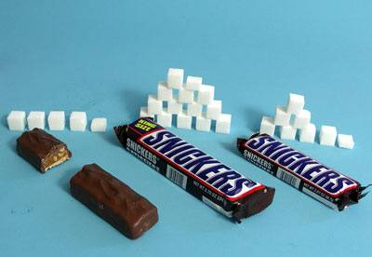
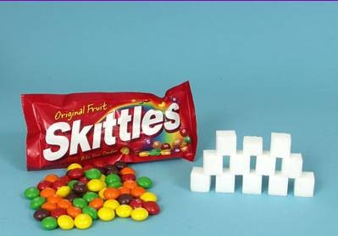
Choose Low-Sugar Foods

Slide 22
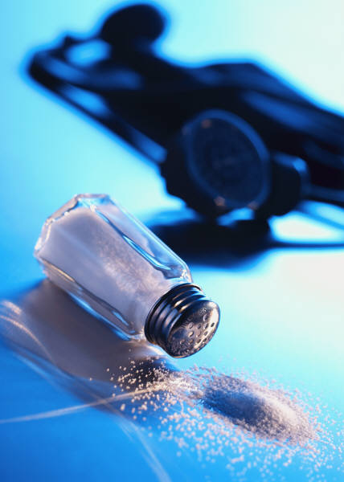
Choose Low-Sodium Foods
Why is it important?
Reduce high blood pressure.
Reduce fluid retention.

Slide 23

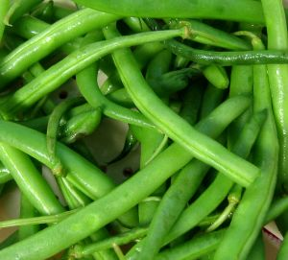
Choose Low-Sodium Foods
½ cup = 400mg sodium
½ cup = 1mg sodium

Slide 24
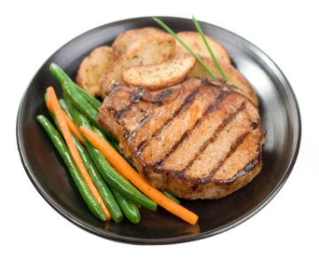

Choose Low-Sodium Foods
3 oz = 48 mg sodium
1 hotdog = 990 mg sodium

Slide 25
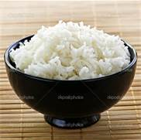
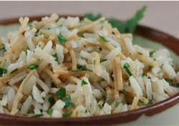
Choose Low-Sodium Foods
½ cup = <1mg sodium
½ cup = 600mg sodium

Slide 26
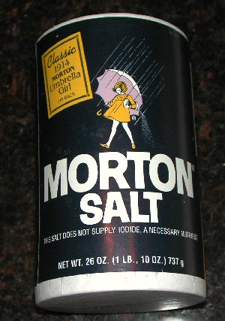
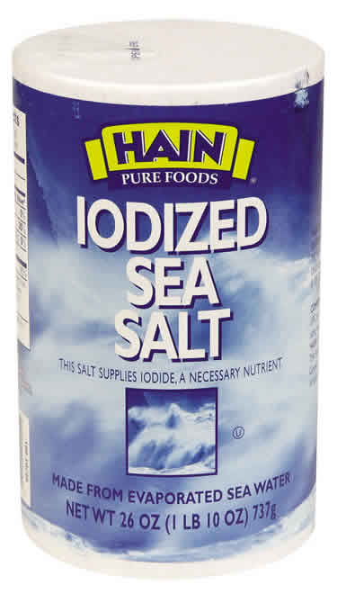
Choose Low-Sodium Foods
1 tsp = 2400 mg sodium
1 tsp = 2400 mg sodium

Slide 27

Choose Low-Sodium Foods
Choose cooking herbs to flavor food:
Other cooking herbs that are ok:
bay leaf, chili powder, chives, cilantro, cumin, dill weed, dry mustard, garlic, onion, peppers, poultry seasoning, rosemary, thyme

Slide 28
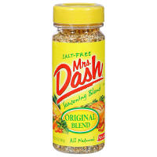
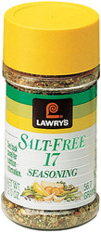
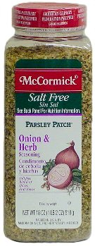
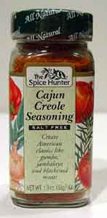
What salt substitutes are ok?
Mrs. Dash salt-free
Seasoning blends &
marinades
Lawry’s salt-free
17 seasonings
The Spice Hunter
Salt-free seasoning
line
McCormick’s Salt-free
seasonings

Slide 29
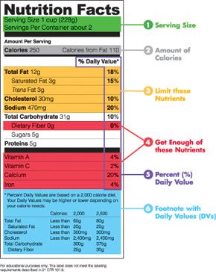

Slide 30
Helpful Resources
Additional Resources
Websites | www.choosemyplate.gov
 | www.cookinglight.com
 | www.mealsforyou.com
Phone Apps | My Fitness Pal
 | Calorie Counter
 | Fooducate
 | FoodLogger
 | MyPlate
 | Nutrition Tips
Books | American Dietetic Association Complete Food and Nutrition Guide, 4th Edition
 | The Complete Idiot's Guide to: The TLC Diet

Slide 31
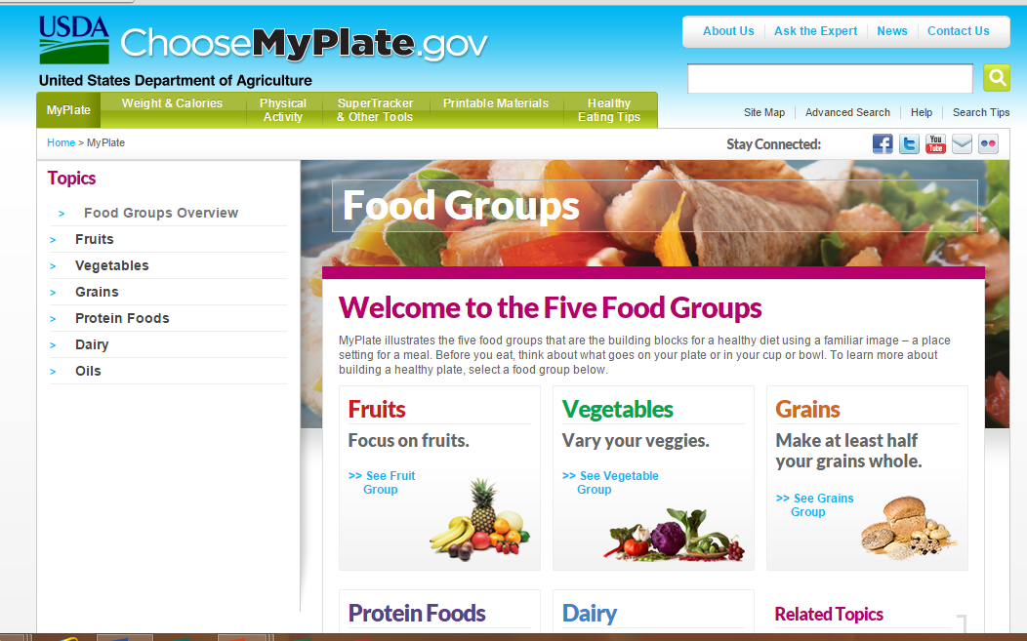

Slide 32
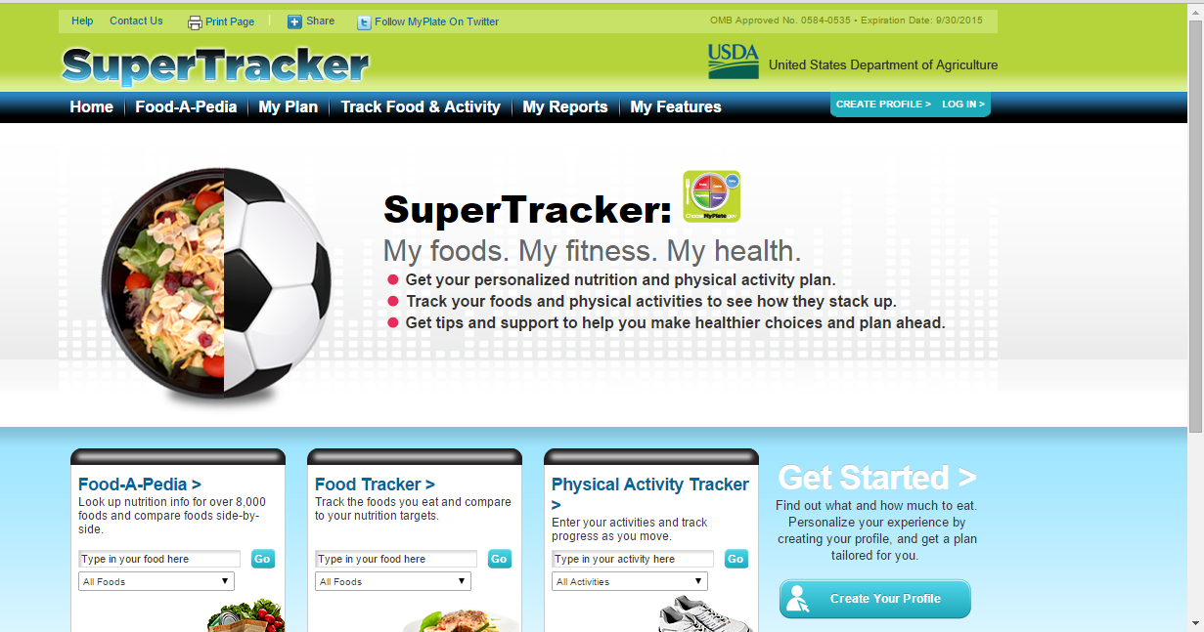

Slide 33
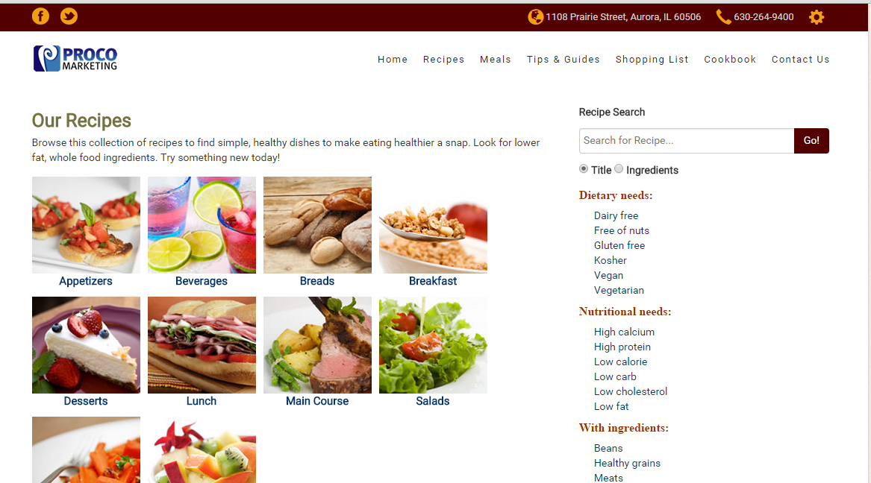

Slide 34
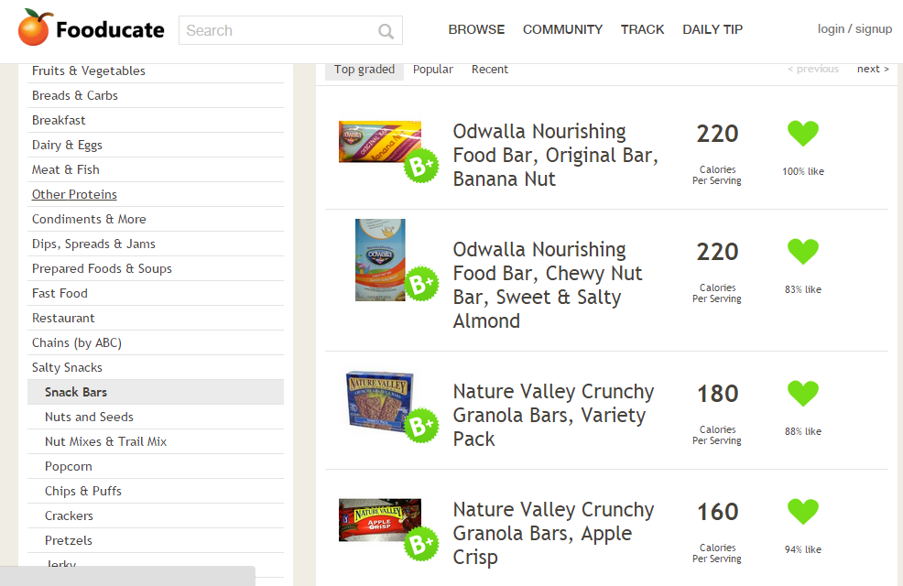
Fooducate

Slide 35
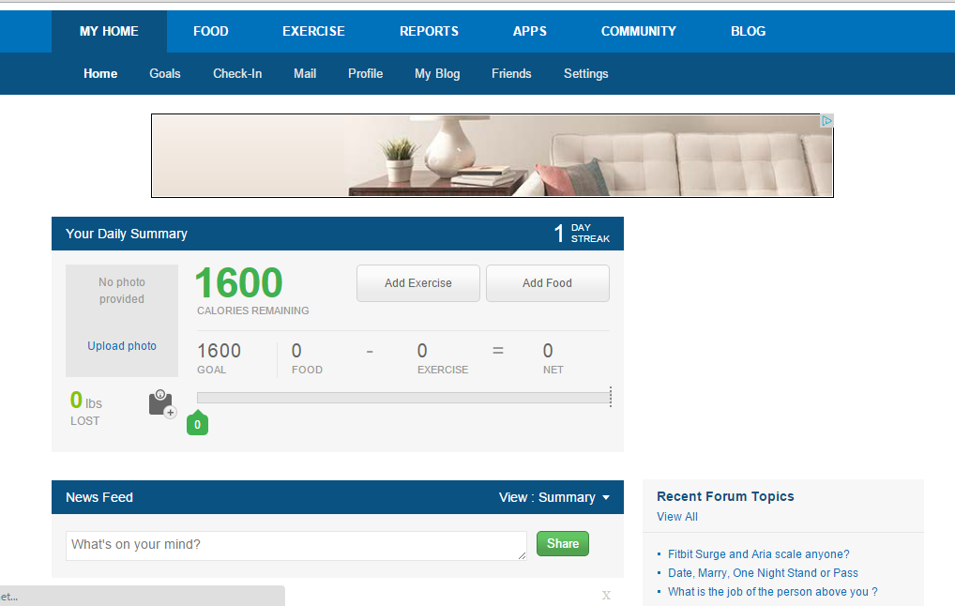
My Fitness Pal

Slide 36
Eating Healthy
Variety
Moderation

Slide 37
Additional Resources
Find a RDN: http://www.eatright.org/find-an-expert
Guide to Healthy Websurfing: http://www.nlm.nih.gov/medlineplus/healthywebsurfing.html
Sloan Kettering About Herbs: http://www.mskcc.org/cancer-care/integrative-medicine/about-herbs-botanicals-other-products
NIH Botanical Supplements: http://ods.od.nih.gov/factsheets/BotanicalBackground-HealthProfessional/

