Slide 1

Advances in PSC Research and Future Directions
David N. Assis, MD
Assistant Professor of Medicine
Yale University

Slide 2
I have no disclosures relevant to this presentation.

Slide 3
Outline
Major Challenges in PSC
Research Advances to meet those Challenges
Future Directions

Slide 4
Key Basic Science Needs in PSC
What are the mechanisms that result in PSC?
Do different forms of injury present in the same way?
Much is still unknown about PSC itself!
PSC
Bile Acids
Toxic Injury
Inflammation
Immune System
Self-reacting lymphocytes
Inflammation
Liver-Gut Axis
Altered Microbiome
Colitis
Bile Duct Scars
Progressive
Fibrosis

Slide 5
Key Clinical Needs in PSC
Biomarkers
Predict high risk of progression at the time of diagnosis
Predict risk of bile duct cancer (cholangiocarcinoma)
Management
Monitoring for disease progression
Standardized treatments for bile duct strictures (blockages)
Screening methods to detect early cancer
Treatment
What approach to take? (immune system, bile acids, scars)
Effective early therapy
Effective late therapy and for recurrence after transplant
Endpoints for clinical trials?
Dyson et al. J Hepatol. 2015 Jan;62(1):208-18.

Slide 6


Slide 7


Slide 8
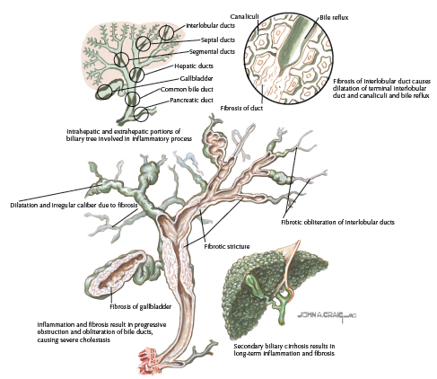
Bile Duct Inflammation➔Alkaline Phosphatase⬆
Netter’s Gastroenterology. 2nd Edition. 2010.

Slide 9
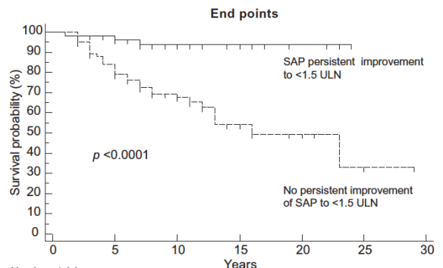
Alkaline Phosphatase
Surrogate marker of disease outcomes?
Mamari et al. J Hepatol 2013;58:329-34.
Notes:
Responders: Normalization of AP

Slide 10
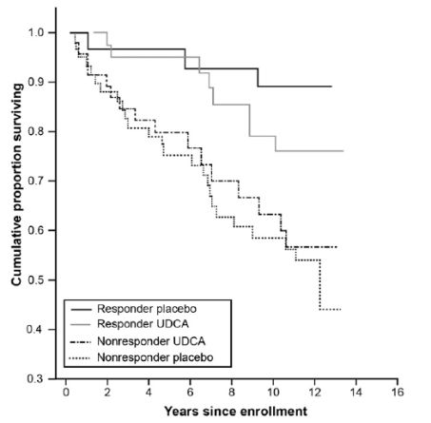
Alkaline Phosphatase
Level
Reduced
Level Not Reduced
Lindström et al. Clin Gastroenterol Hepatol. 2013;11:841-6.
Notes:
Responder: at least 40% AP reduction

Slide 11
Predictors of Progression
UK-PSC National Cohort (N=1700)
Data analyzed from 500 patients
Factors associated with increased need for liver transplant:
Elevated Alkaline Phosphatase
> 2 x normal at baseline (diagnosis)
> 1.5 x normal 1 year after diagnosis
> 2 x normal 2 years after diagnosis
Protective Factors:
Small-duct PSC (no cholangiographic changes)
PSC limited to the liver (no extra-hepatic bile duct changes)
Goode et al. EASL 2015 [Abstract #80].
Notes:
ULN: upper limit of normal
HR: hazard ratio
Factors associated with increased need for transplantation:
Elevated Alkaline Phosphatase
> 2x ULN at baseline (diagnosis), HR 2.32 [1.43-3.77, p=0.008]
>1.5x ULN 1 year after diagnosis HR 2.92 [1.85-4.59, p<0.001]
> 2x ULN 2 years after diagnosis, HR 2.96 [1.23-7.13, p=0.015]
Protective Factors:
Small-duct PSC (no cholangiographic changes), HR 0.28 [0.11-0.72, p=0.008]
PSC limited to the liver (no extra-hepatic bile duct changes), HR 0.57 [0.35-0.94, p=0.027]

Slide 12
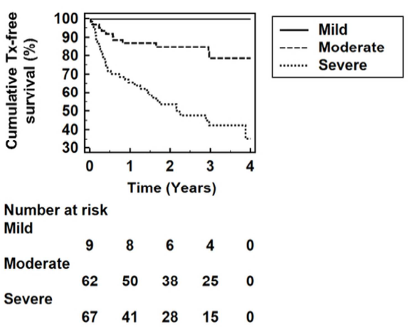
Enhanced Liver Fibrosis Panel (ELF®)
Blood levels of Hyaluronic acid, TIMP1, and PIIINP
Vesterhus et al. Hepatology 2015 (in press).

Slide 13
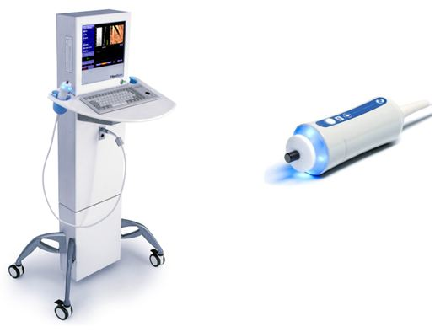
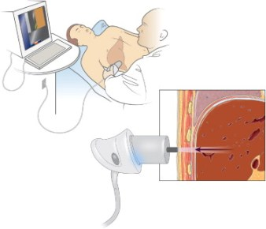
Transient Elastography (Fibroscan®)
Notes:
LSM: liver stiffness measure
Cut-off values: ≥F2 of 8.6 kPa and F4 of 14.4 kPa
Dramatic change in survival if > 18.5
Also helpful longitudinal changes over time!

Slide 14
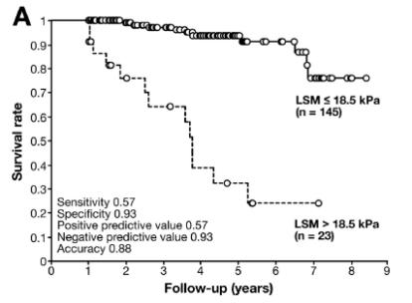
Transient Elastography (Fibroscan®)
Marker of PSC disease progression and prognosis?
Corpechot et al. Gastroenterology. 2014;146:970–979
Notes:
LSM: liver stiffness measure
Cut-off values: ≥F2 of 8.6 kPa and F4 of 14.4 kPa
Dramatic change in survival if > 18.5
Also helpful longitudinal changes over time!

Slide 15
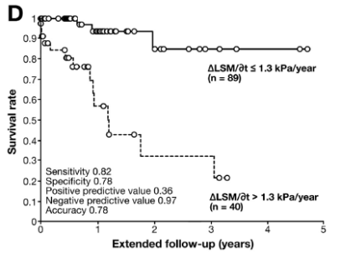
Transient Elastography (Fibroscan®)
Marker of PSC disease progression and prognosis?
Corpechot et al. Gastroenterology. 2014;146:970–979
Notes:
LSM: liver stiffness measure
Cut-off values: ≥F2 of 8.6 kPa and F4 of 14.4 kPa
Dramatic change in survival if > 18.5
Also helpful longitudinal changes over time!

Slide 16
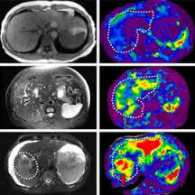
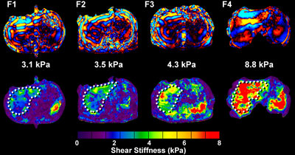
MR Elastography in PSC?

Slide 17
Emerging Therapies
Immune Modulators
Microbiome Modulators
PSC
Bile Acids
Toxic Injury
Inflammation
Immune System
Self-reacting lymphocytes
Inflammation
Liver-Gut Axis
Altered Microbiome
Colitis
Bile Duct Scars
Progressive
Fibrosis
Bile & Bile Acid
Modulators
Anti-Fibrotics

Slide 18

norUDCA (norUrso)
C₂₃-homolog of Ursodiol
Pre-clinical studies:
Anti-cholestatic, Anti-inflammatory, Anti-proliferative, Anti-fibrotic
In an early human study it was well tolerated
Ongoing Phase II study in PSC:
Double-blind, randomized, multi-center, placebo-controlled for 12 weeks with 160 subjects
Goal: dose-finding
Measure of effect: alkaline phosphatase
Fickert et al. J Hepatol. 2013;58:1201-8.
NCT 0175507
Notes:
Mdr2 KO model

Slide 19
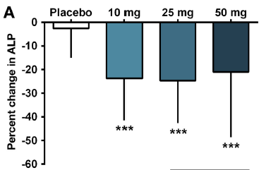
Obeticholic Acid (OCA)
New study showed reduction in alkaline phosphatase in PBC
Effect in PSC needs to be evaluated
Ongoing Phase II Study in PSC:
Randomized, double-blind, placebo controlled
24 weeks with 75 subjects
Dose titration: 1.5 → 3 mg, 5 → 10 mg OCA
Important since the drug can cause itching as a side effect
Measure of effect: alkaline phosphatase
Hirschfield et al. Gastroenterology 2015; 148:751-61.
NCT02177136

Slide 20
Immunomodulators
Vascular adhesion protein (VAP-1)
Normal liver expression, weak in GI mucosa
Highly expressed in the GI in Colitis → Vedolizumab
PSC: VAP-1 increased recruitment of lymphocytes to hepatic endothelial cells
Liaskou et al. Hepatology. 2011;53:661-72.
Courtesy of David Adams, Tom Karlsen.
Notes:
VAP-1 is a semicarbazide-sensitive amine oxidase adhesion molecule that supports lymphocyte recruitment to the liver
Complementary expression with mucosal addressin cell adhesion moleule 1 (MadCAM-1)
Vedolizumab is an alpha4/beta7 monoclonal antibody that selectively blocks the influx of gut-homing lymphocytes to the intestine

Slide 21
Immunomodulators
Vedolizumab
Alpha4/beta7 monoclonal antibody that blocks the influx of unwanted lymphocytes to the intestine and binding to adhesion molecules (MADCAM-1)
FDA-approved anti-VAP-1 therapy for Inflammatory Bowel Disease (2014)
New Phase 3 study in PSC:
Patients with PSC + Ulcerative Colitis
2 year study
Measure of effect: alkaline phosphatase, histology

Slide 22
Vancomycin
Pediatrics
PSC and Inflammatory Bowel Disease
Abarbanel et al. J Clin Immunol. 2013;33:397-406.

Slide 23
Vancomycin
Ongoing Phase 3 study in PSC:
Children and adults
Three months of therapy
40 subjects
Measure of effect: GGT, ALT, liver biopsy
Salivary and fecal microbiome changes
NCT 01802073

Slide 24
Value Based Medicine in PSC?
Healthcare Value = Outcome Cost
Expert Consensus (Delphi Method)
Outcomes of Interest:
Annual rate of acute cholangitis (bile duct infections)
Mortality rate for those not yet listed for transplant
Rate of improvement in quality of life
Number patients who died of cancer (bile duct, colon)
Incidence and worsening of osteoporosis (bone disease)
Porter. N Engl J Med 2010; 363:2477-2481.
Fabris et al. EASL 2015 [Abstract #1169].

Slide 25
Major New Initiatives in PSC
PSC Partners Patient Registry
Great opportunity for data collection and sharing
International PSC Study Group (IPSCSG)
Cutting edge research collaboration on clinical and basic science
North American Autoimmune Liver Disease Consortium
Prospective data collection on variables of disease
Pending Study on African Americans and Hispanics with PSC
FDA Meeting on Defining Clinical Trial Endpoints
August 27 and 28, 2015

Slide 26
Conclusions (1)
There are critical unmet needs:
Understanding the mechanisms of PSC
Improving clinical care of PSC
We are moving toward optimizing how we measure the status of PSC and predict its future course for patients
Blood tests of inflammation
Blood tests of fibrosis (scars)
Imaging tests

Slide 27
Conclusions (2)
Several potential new therapies are attempting to treat PSC from different aspects based on different mechanisms
Combination therapy may be needed to yield better outcomes
We must remember to define Value in PSC care
Collaborative efforts will help us to get the answers to urgent questions.

Slide 28

Every Wall is a Door.
Ralph Waldo Emerson

