Slide 1
Living Donor Liver Transplantation in PSC Patients
Giuliano Testa, MD, FACS, MBA
Surgical Director, Living Donor Liver Transplantation
Baylor University Medical Center
Annette C. and Harold C. Simmons Transplant Institute

Slide 3
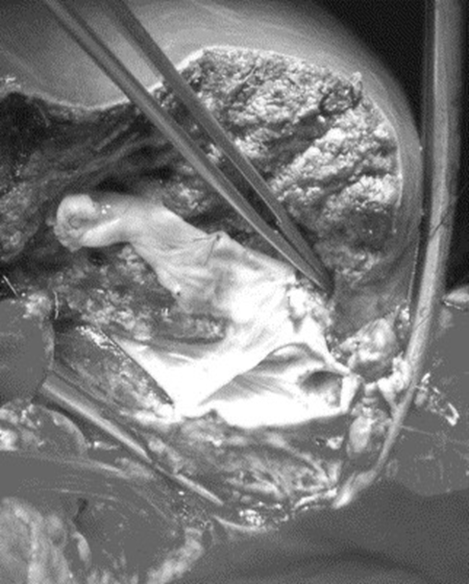

Donor
Age 18-55 (rarely 55-60)
Perfect physical and mental health
Appropriate Liver Volume & Anatomy (% resection less important than RDV/DW ratio or SLV)
Emotional connection

Slide 4
LivingDonorLiverTransplant
        Who are the best candidates?
        Patients with:
        Intractable ascites
        Encephalopathy
        Recurrent variceal bleeding
        HCC over UNOS criteria
        Cholestatic liver disease
        In general, all patients with established cirrhosis, low MELD, and a severely diminished quality of life

Slide 5
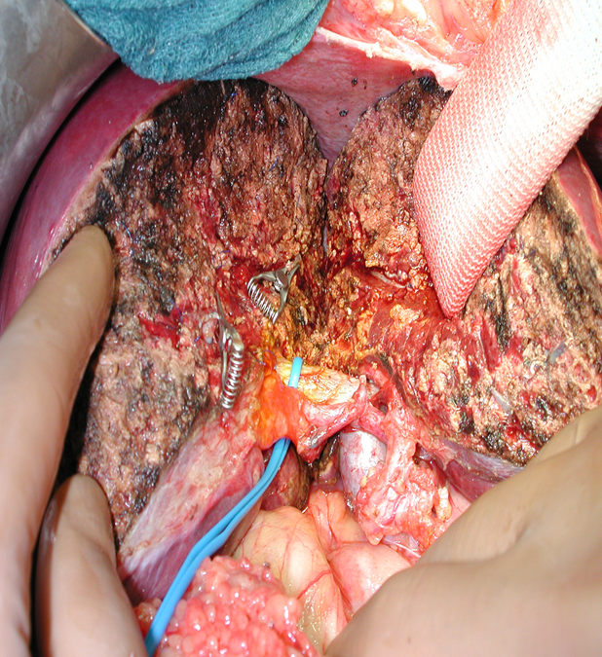
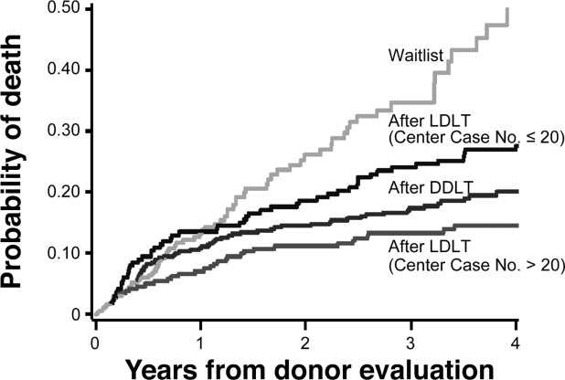
Why Living Donor Liver Transplantation?
In fact, the magnitude of mortality reduction was among the largest observed with any form of transplant intervention
A2ALL Study Group Gastroenterology 2007, Pages 1806-1813

Slide 6
How living donor liver transplant changes the scenario
LivingDonorLiverTransplant
        It offers an opportunity to patients who:
have a little chance of receiving a cadaver liver transplant because they are “not sick enough”
do not qualify for cadaver liver transplant because of the nature of their liver disease (hepatocellular carcinoma, polycystic liver disease, etc.)

Slide 7
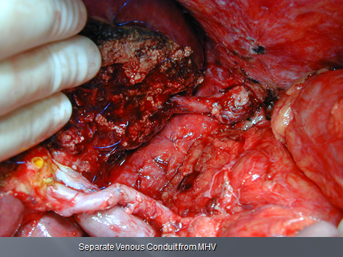
Why Living Donor Liver Transplant?
Chronic lack of suitable deceased donors (only number increase in less quality organs)
Increasing MELD at transplantation
Tangible benefits for the recipients and for the transplant program

Slide 9
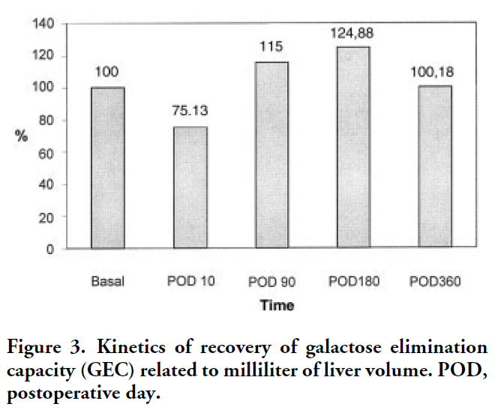
Regeneration n=40
2000
1500
1000
500
Rest Volume (ml)
Mean
Regeneration 3 Months
Volumetric and Functional Recovery of the Liver After
Right Hepatectomy for Living Donation
Silvio Nadalin, Giuliano Testa, Massimo SMalago´, Mechtild Beste, Andrea Frilling, Thobias Schroeder, Christoph Jochum, Guido Gerken, and Christoph E. Broelsch
Liver Transplantation, Vol 10, No 8 (August), 2004: pp 1024–1029

Slide 10
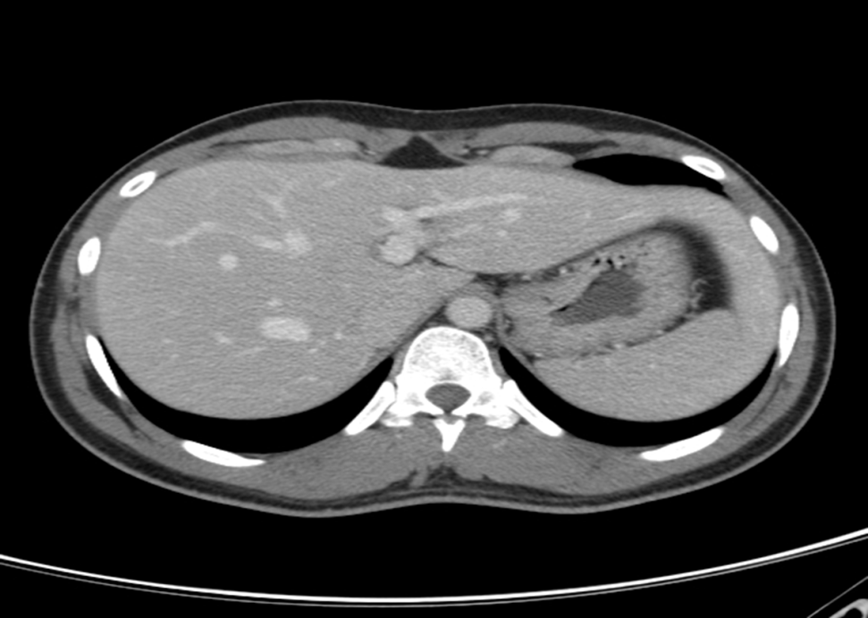
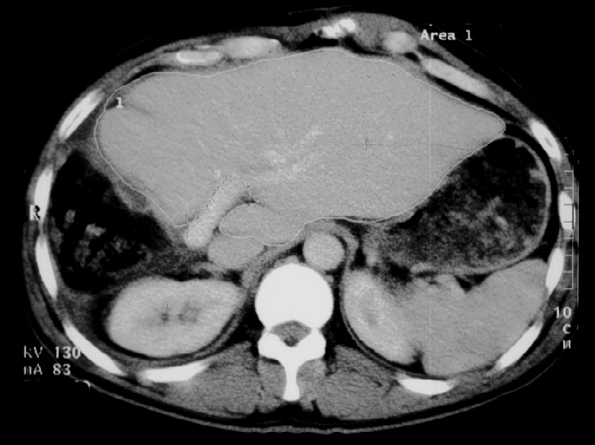

Slide 11
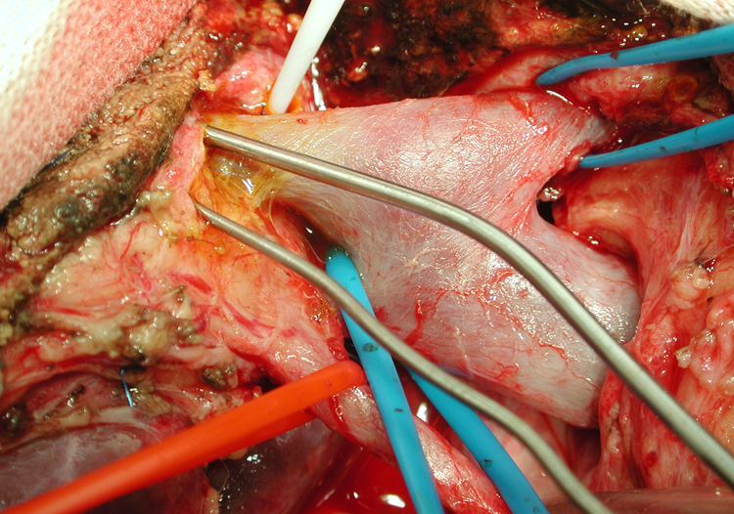
Donor
Blood work and ABO
MRCP/MRA
Donor Advocate Team (Social Worker, Hepatologist, Donor Advocate Physician)
Liver biopsy

Slide 13
Is living donor liver transplantation an option?
When is living donor liver transplantation indicated?
What is the expected outcome after living donor liver transplantation?

Slide 14
When is living donor liver transplant indicated?
Anytime liver transplant is indicated
Anytime the recipient can be a candidate for a living donor liver transplant and a donor is stepping forward

Slide 15
What will make a patient not a candidate for a living donor liver transplant?
poor renal function
size

Slide 16
What is and when is living donor liver transplantation indicated?

Slide 17
Insert slides regarding living donor liver transplantation

Slide 18
Transplant when?
Quality of life
Survival
Risk of cancer

Slide 19
Quality of life
For some is not an indication to proceed to LTX*
Decision taking into consideration: immediate risk; lifelong need for immunosuppression; risk of recurrence
In my opinion, each case should be individually judged
* Tamura S, World Journal of Gastroenterology, 2008

Slide 20
Survival
Decision can be based on crude MELD score; for some centers MELD >15
When the risk of death by natural disease course is predicted to outweigh the risk of death of liver transplant
Natural History: median survival form diagnosis 12 years*
In my opinion, MELD alone should not be the decisive factor
* Wiesner RH, Hepatology 1989
Notes:
MELD of 15 has an expected mortality at 3 months of 5%

Slide 21
MELD does not correctly reflect the degree of illness in PSC patients (often very high bilirubin not accompanied by parallel increase in creatinine/INR)
Notes:
often INR and creatinine are not elevated and when they become elevated the pts may not be candidate any longer

Slide 22
Risk of Cancer
Reported between 6% to 36% of patients
Cancer significantly changes outcome
Cohort of 171 patients, 25 (15%) developed CCC
7/25 underwent transplantation
In my opinion: the occurrence of new dominant stricture / change in existing stricture should prompt evaluation for LTX
Goldberg DS, Liver Transplantation 2013; Goldberg DS, Transplantation 2011

Slide 23
1 year 97.2%
3 years 95.4%
5 years 87.5%
Same/better than deceased donor liver transplant
Kashyap RJ, Gastrointest Surg 2010

Slide 24
Wait times to LTX are longer for pts with PSC and became longer after MELD introduction*
PSC pts are more likely to receive an LDLT*
Lower risk of graft failure for LDLT vs LTX*
* Goldberg DS, Transplantation 2011; Goldberg DS, Hepatology 2014

Slide 25
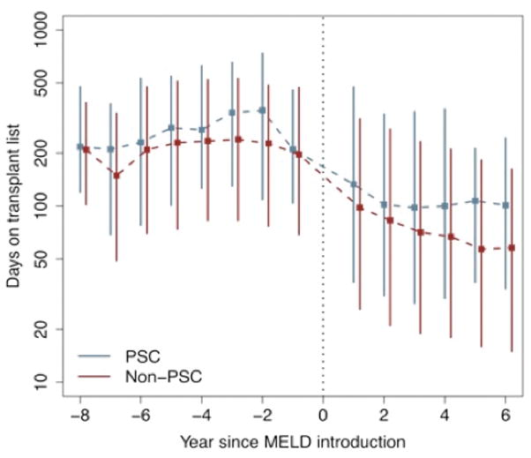


Slide 26
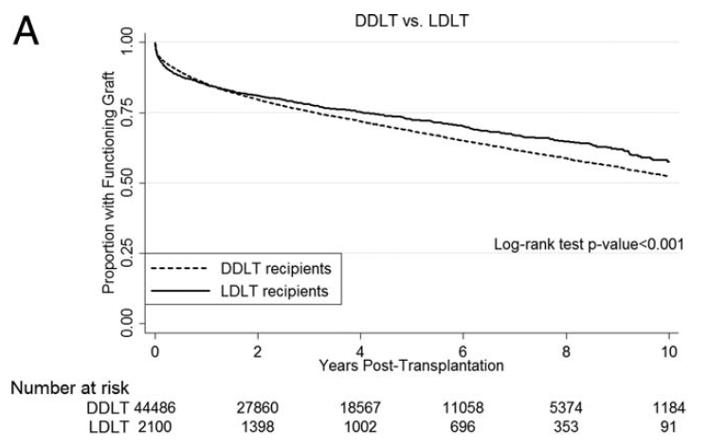
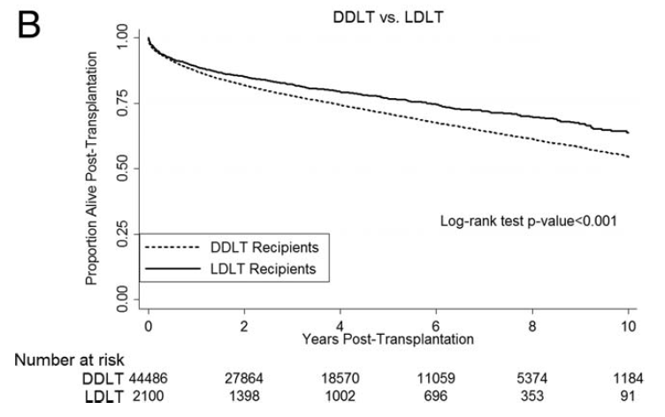
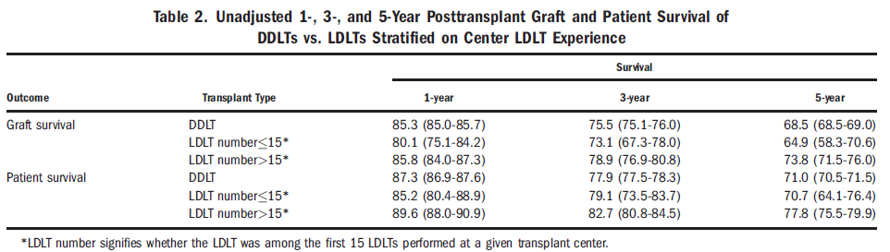

Slide 27
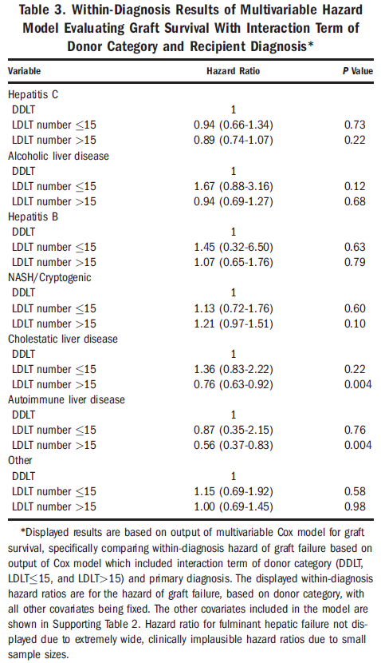

Slide 28
